Slide 1
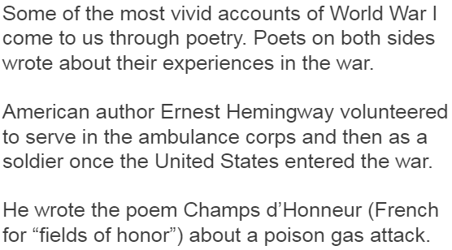

Slide 3
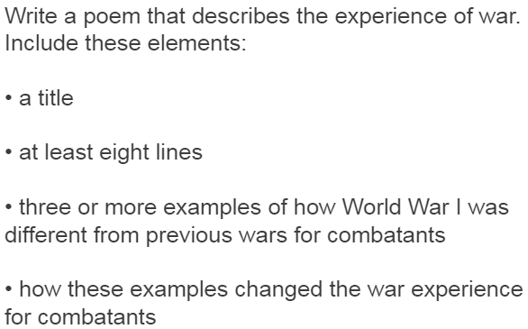
**try use the terms to know ** read 24 when finished
Annotate your poem with important historical information about WWI.
A: 5+ impressive annotations, detailed and specific and important
B: 5+ helpful annotations
C: some helpful annotations
D: it’s a poem about WWI that someone else could annotate

