Slide 1
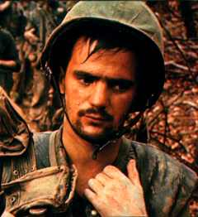
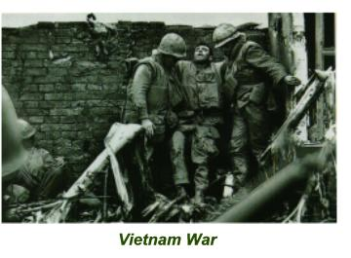
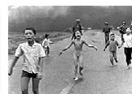
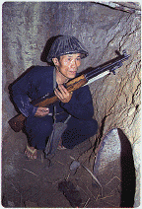
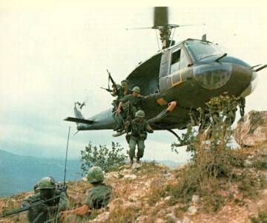
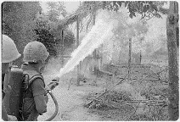
The Vietnam War

Slide 2
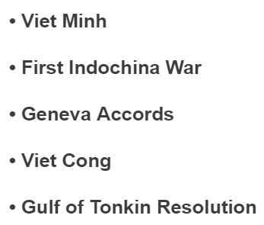
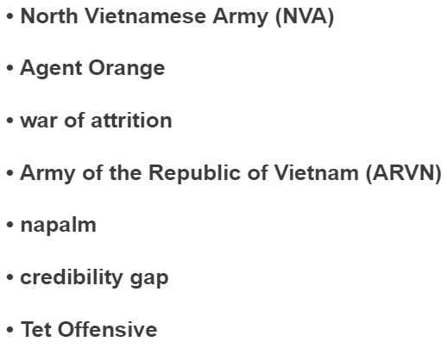
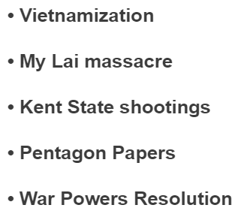

Slide 3
Overview: In 1954, Vietnam was divided into two states: communist North Vietnam and non-communist South Vietnam. When Vietnamese communists began attacking South Vietnam, the U.S. sent troops to help. At one point, over 500,000 U.S. troops were fighting in support of South Vietnam.
Eventually, many Americans came to believe that U.S. troops should be withdrawn. The war became one of the most divisive and unpopular causes in U.S. history. In 1973, a cease-fire agreement with North Vietnam was signed and U.S. forces withdrew. Two years later, Vietnam was reunited under communist rule.

Slide 4
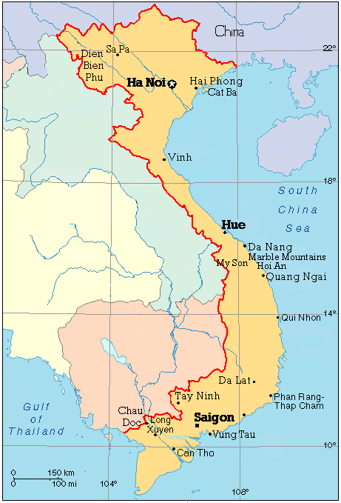
Geography
Located in Southeast Asia, Vietnam is rich in resources such as coal, iron ore, petroleum, mercury and tin.
Laos
Gulf of
Tonkin
17th Parallel
Thailand
Cambodia

Slide 5
Cause: Starting in 1858, the French colonized and controlled most of Southeast Asia and began to utilize their valuable resources. The region became known as French Indochina.
Laos
Gulf of
Tonkin
17th Parallel
Thailand
Result: Ho Chi Minh’s Indochinese Communist Party led strikes and revolts against the French.
Cambodia

Slide 6
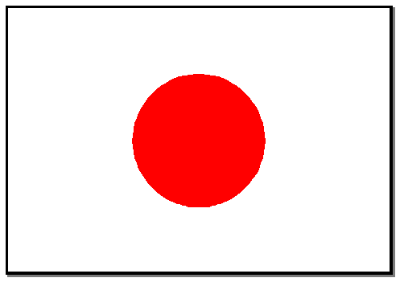
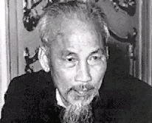
World War II
1940- During World War II, Japan seizes control of Vietnam.
1941- Happy to see the French gone, the Vietnamese still feared the Japanese. As a result, Ho Chi Minh and others found the Vietminh (Independence) league

Slide 7
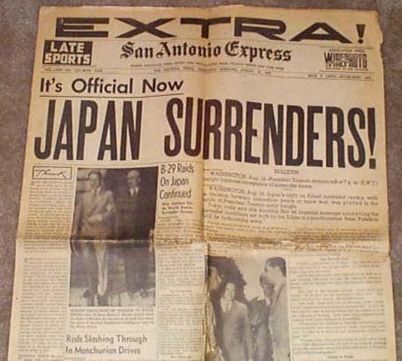
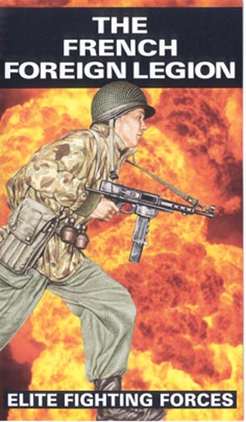
Cause: Japan leaves Vietnam in 1945 after its defeat in WWII.
Result: The French try to regain the former colony.

Slide 8
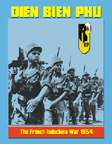
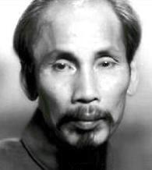
Independence Movement
At last, we are finally free of those pesky foreigners!!!
Cause: In 1954, the French are defeated at Dien Bien Phu.
Result: The French surrender to Ho Chi Minh.

Slide 9
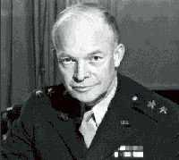
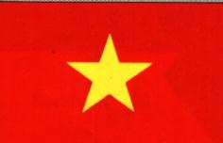
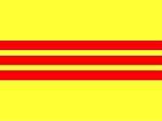
Cause: Rising communist sentiment in Vietnam leads U.S. President Eisenhower to describe the situation as the “domino theory.” (The fall of one country to communism will lead to the fall of its neighbors)
Result: In 1954, An International Peace Conference divides Indochina at the 17th parallel.
North Vietnam –Led by Ho Chi Minh’s communist forces and supported by the USSR and China
South Vietnam –Led by an anti-Communist government under the rule of Ngo Dinh Diem and supported by the U.S. and France.

Slide 10
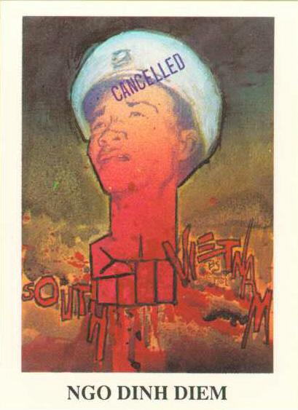
The Kennedy administration seemed split on how peaceful or democratic the Diem regime really was. Some Kennedy advisers believed Diem had not instituted enough social and economic reforms to remain a viable leader in South Vietnam. Others argued that Diem was the
"best of a bad lot."
Should the United States support Ngo Dinh Diem?
President Diem maintained that South Vietnam was a peace-loving democracy and that the Communists were out to destroy his new country.

Slide 11
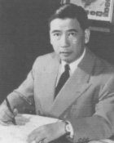
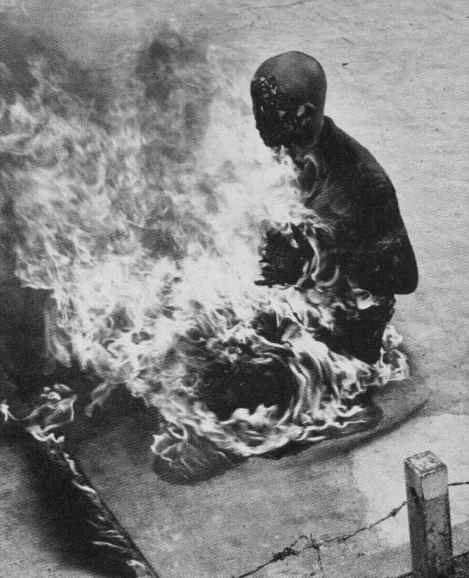
Cause: Diem and his brother, Ngo Dinh Nhu, began raiding Buddhist pagodas in South Vietnam, claiming they were harboring Communists.
Result: Massive protests on the streets of Saigon took place including the self-immolation of many Buddhist monks.

Slide 12
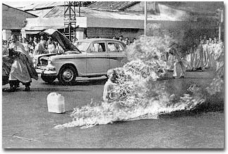
Why would these Buddhist monks perform such an act?
The pictures of the monks engulfed in flames made world headlines, bringing attention to the corrupt government of Ngo Dinh Diem.

Slide 13
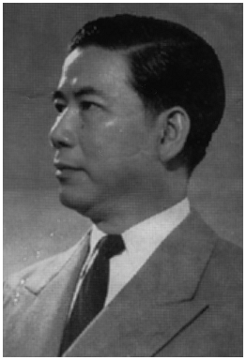
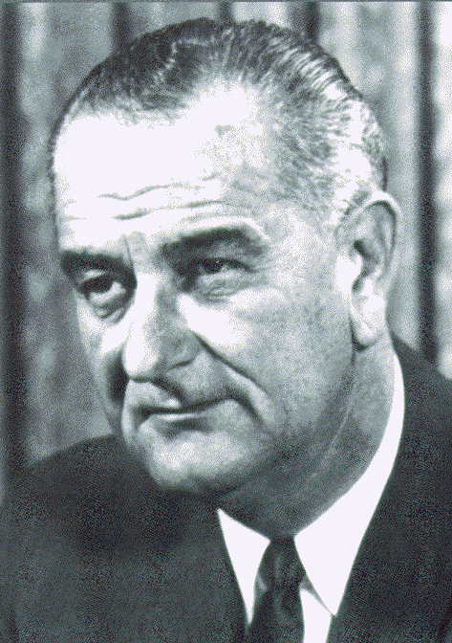
A Change in Leadership
Cause: Diem is an unpopular, corrupt, dictator and decides NOT hold scheduled elections that were promised to the people. (The U.S. supported his decision because they thought the Communists would be elected.)
Result: In 1963, a U.S. backed group of South Vietnamese generals plan a coup. They overthrow and assassinate Diem. Later that month, President Kennedy was also assassinated and Lyndon Baines Johnson (LBJ) became President.

Slide 14
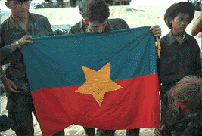
Cause: The U.S. feels that the new leaders were no more popular than Diem and they feared a Communist takeover.
The National Liberation Front: Founded in 1960, this South Vietnamese group supported the unification of Vietnam and opposed Ngo Dinh Diem and the U.S. presence in Vietnam. The group came to be known as the Viet Cong (VC).
Result: The U.S. increases the number of military advisors and aid to South Vietnam.

Slide 15
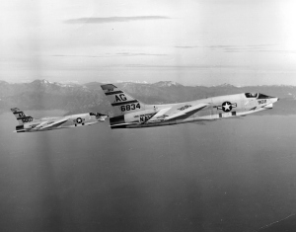
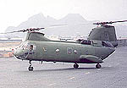
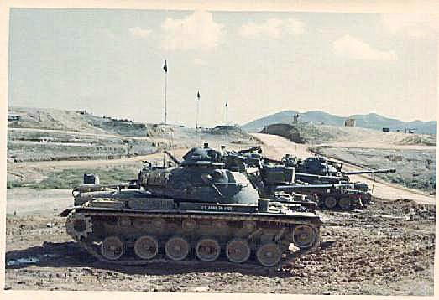
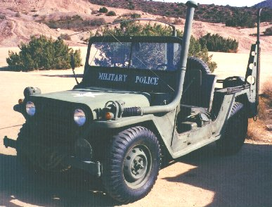
Soon, the number of planes, tanks and other military equipment sent to South Vietnam increases.

Slide 16
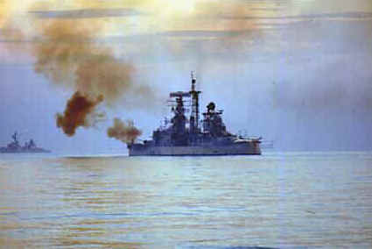
The Spark of the Vietnam War!
Cause: By August of 1964, the U.S. needed justification for its increasing presence in Vietnam.
Result: U.S. President LBJ told Congress that North Vietnamese patrol boats had attacked two American destroyers in the Gulf of Tonkin. One of the attacks was never proven to have happened.

Slide 17
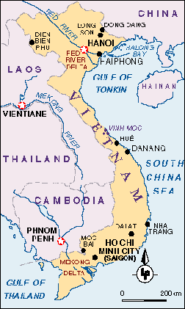
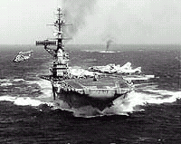
Gulf of Tonkin

Slide 18
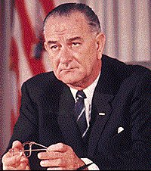
President Johnson's Message to Congress August 5, 1964
What does President Johnson
want from Congress?
“The North Vietnamese regime has conducted further deliberate attacks against U.S. naval vessels operating in international waters… These latest actions of the North Vietnamese regime has given a new and grave turn to the already serious situation in southeast Asia.”
“I want to ask the Congress for a resolution expressing the unity and determination of the United States in supporting freedom and in protecting peace in southeast Asia.
This resolution obligates the United States and other members to act against Communist aggression in any nation.”

Slide 19
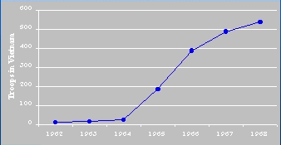
Gulf of Tonkin Resolution
On August 5, 1964 Congress passed the Gulf of Tonkin Resolution that authorized the President to use war powers and send American troops into Vietnam.
Compare the amount of troops sent to Vietnam in 1964 to 1968.
500,000 TROOPS
BY 1968!

Slide 20
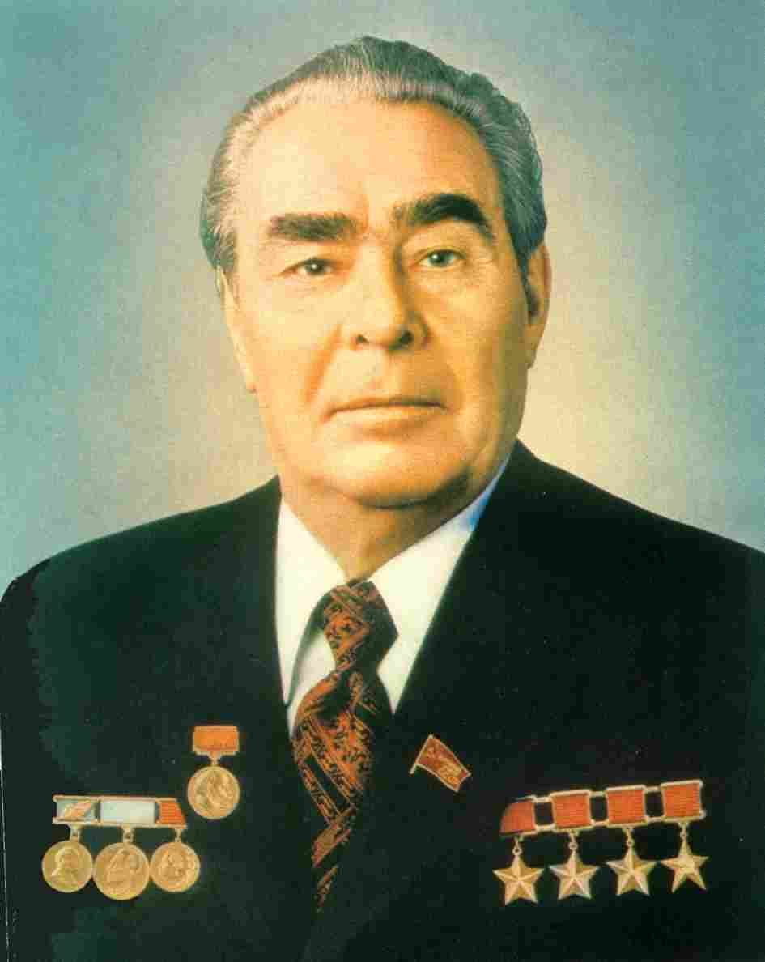
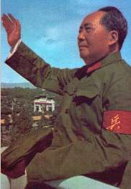
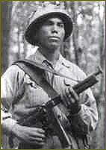
Me too. Slap me five Lenny!
You need soldiers and guns? No problem, I’ve got plenty.
I’ve got your back, Ho.
At the same time, popular support for the Vietcong grew. Ho Chi Minh strongly supported the Vietcong with troops and munitions, as did the Soviet Union and China.

Slide 21
Me too. Slap me five Lenny!
You need soldiers and guns? No problem, I’ve got plenty.
I’ve got your back, Ho.
At the same time, popular support for the Vietcong grew. Ho Chi Minh strongly supported the Vietcong with troops and munitions, as did the Soviet Union and China.

Slide 22
Who is more patriotic?
  Protesters: “we have a the duty to topple a tyrannical government”
  Advocates: they are doing what they are told and supporting our nation, protesters are hating soldiers for doing their job

Slide 23
Strategies for the War
Who has the advantage?
United States
Will use its superior firepower to force the enemy to surrender
Will use air strikes to bomb the enemy into submission
Will use search and destroy missions to pinpoint enemy bases and supplies.
Will set up blockades to prevent supplies from reaching the enemy.
North Vietnam
Will rely on the Guerilla tactics of surprise and mobility.
Will avoid major head to head battles
Will use knowledge of terrain to their advantage
Will fight during the night and use underground tunnels to confuse enemy.
Will not fight to win, but to prolong the war and never lose.

Slide 24
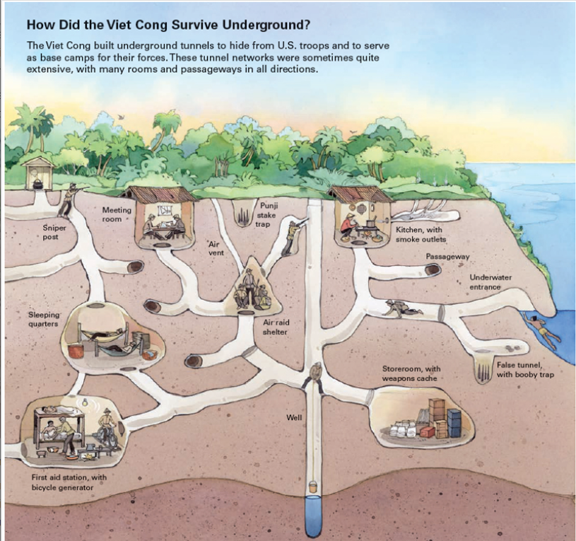

Underground Tunnels

Slide 25
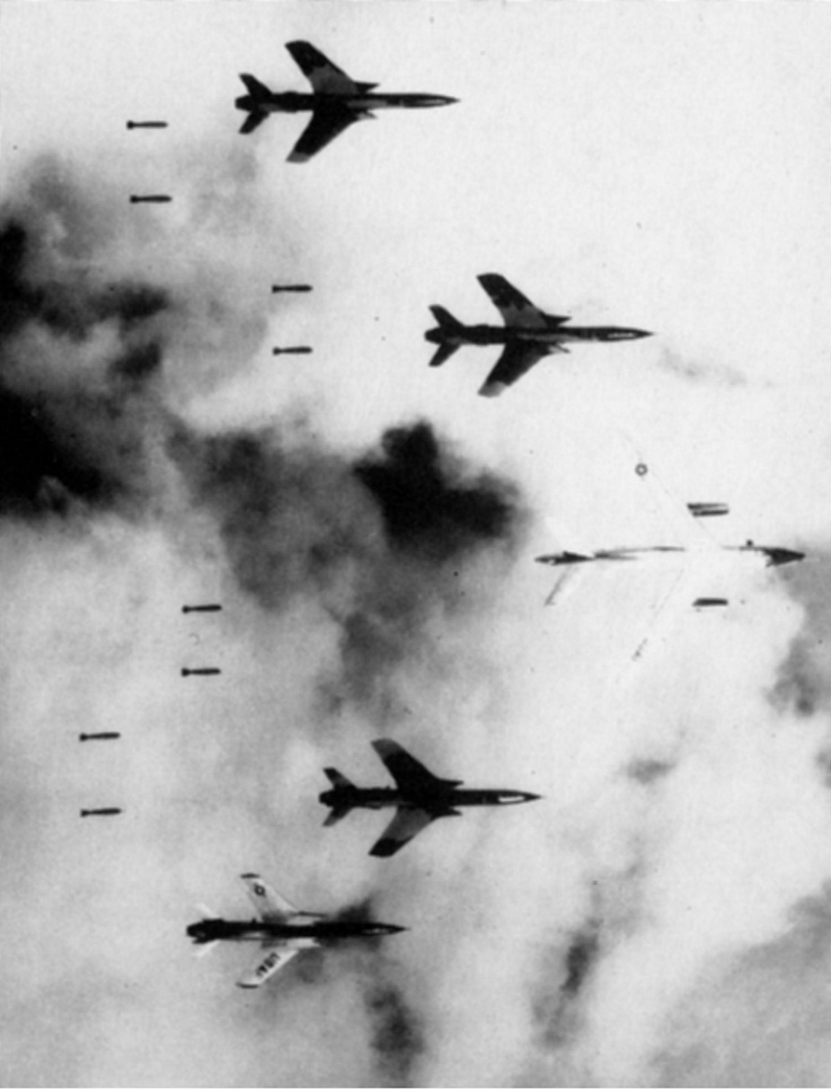
Bombing Campaign
Cause: Unable to win a decisive victory on the ground
Result: The U.S. turned to air power and bombed millions of acres of farmland and forest in an attempt to destroy enemy hideouts.
The U.S. continued to drop bombs on more targets through 1967 causing an estimated $300 million in damage.

Slide 26
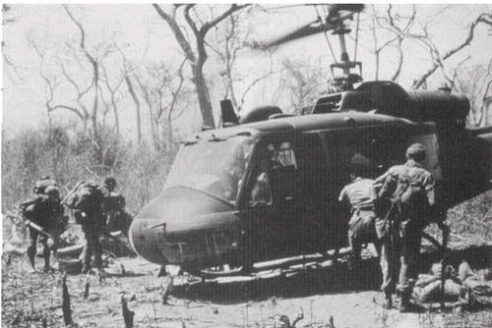
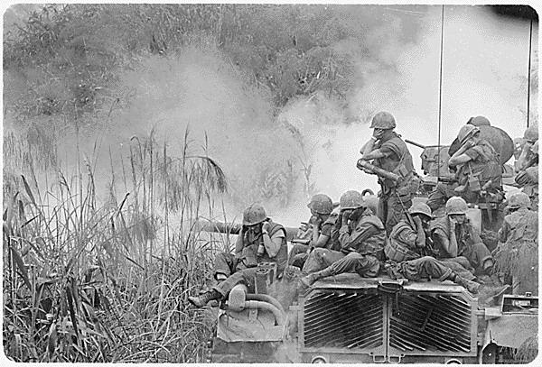
Aerial Objectives
To Destroy the North Vietnamese economy
To Hinder the flow of supplies and men
To Reduce morale and the will to fight
ALL OBJECTIVES FAILED

Slide 27
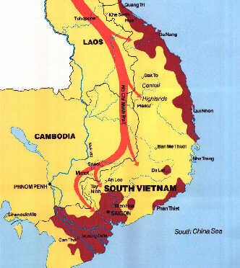
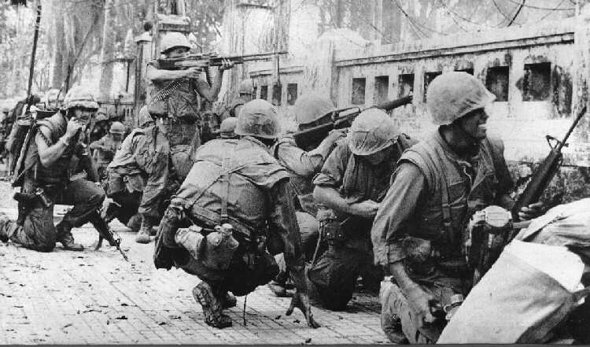
Major Turning Points
The Ho Chi Minh Trail
The Tet Offensive
On January 31, 1968, during the Vietnamese New Year known as Tet, the North Vietnamese communist forces inititated a large scale attack on major South Vietnamese cities and bases.
Why did the north use the Ho Chi Minh Trail and why was it effective?

Slide 28
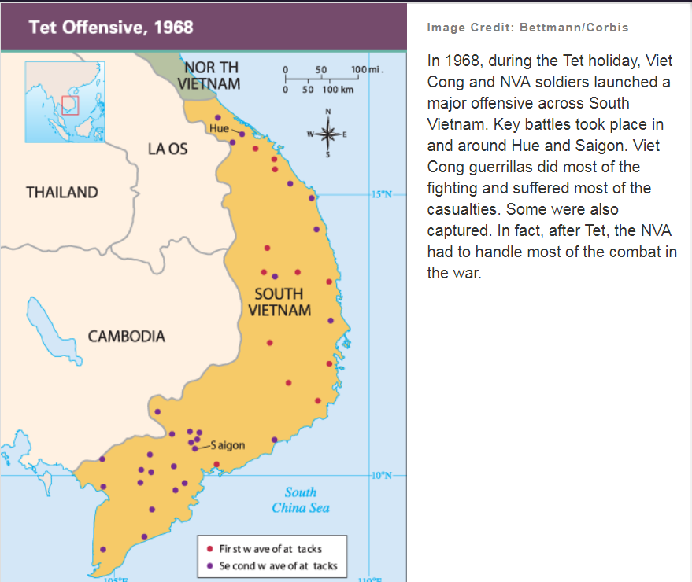

Slide 29
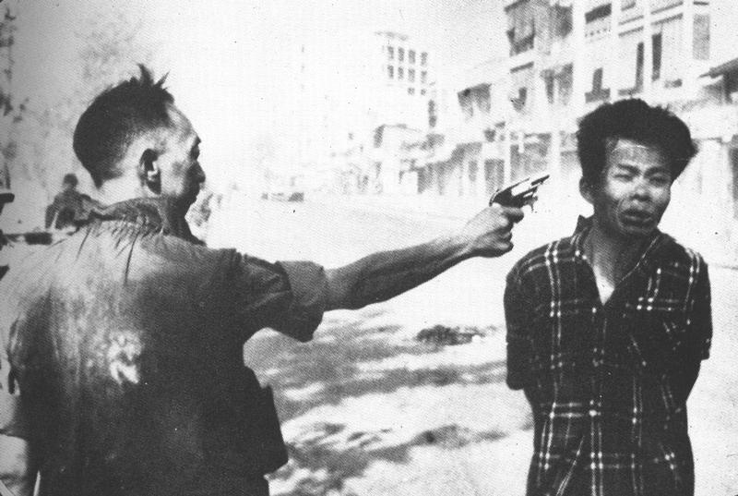
Results of the Tet Offensive
Up to 40,000 communists were killed in action
The U.S. military quickly responded to the surprise attacks and defeated the communists
Almost all territory was regained by the U.S. within a few days
The public saw bloody street fighting and the communist’s temporary occupation of the U.S. Embassy in Saigon.
If the Tet Offensive was a military loss for North Vietnam, then why is it considered a turning point?

Slide 30
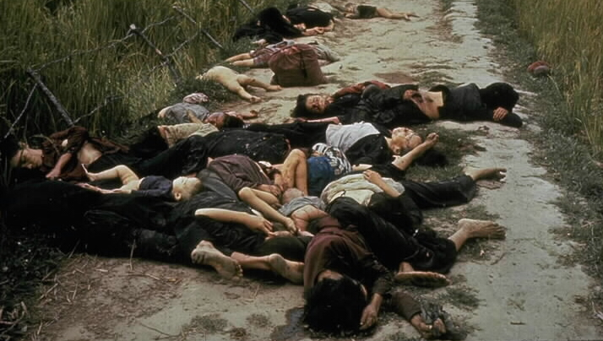
The My Lai Massacre
On March 16, 1968 a “search and destroy mission” unfolded in My Lai, a heavily mined area controlled by the VC. Many soldiers of Charlie Company, 11th Brigade, had been maimed or killed in the area during the preceding weeks. The agitated troops, under the command of Lt. William Calley, entered the village poised for engagement with the elusive Vietcong.

Slide 31
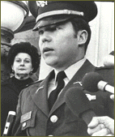
The mission turned into a massacre when Calley ordered his men to enter the village firing, though there had been no report of opposing fire. Over 300 apparently unarmed civilians including women, children, and the elderly were executed. For his part, Calley was said to have rounded up a group of the villagers, ordered them into a ditch, and mowed them down in a fury of machine gun fire.
At his trial, Calley testified that he was ordered by Captain Ernest Medina to kill everyone in the village of My Lai. Still, there was only enough photographic and recorded evidence to convict Calley, alone, of murder. He was sentenced to life in prison, but was released in 1974, following many appeals. After being issued a dishonorable discharge, Calley entered the insurance business.

Slide 32
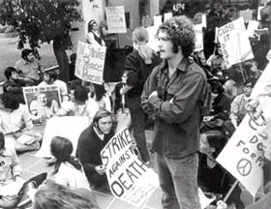
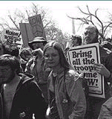

Anti-War Protests on the Homefront
As a result of the military draft, civil rights movement, and television coverage of the war, many college students began to protest the war. 300,000 protested in New York City in August 1967.

Slide 33


Nixon Elected President in 1968
Cause: During the late 1960s, protests against the war became more popular in the U.S. The stress of the war causes LBJ not to run for President for a second term.
Result: Elected in 1968, President Nixon begins withdrawing U.S. troops from Vietnam in 1969. This policy was called “Vietnamization” because it allowed U.S. troops to pull out while the South Vietnamese increased their combat role.

Slide 34


The Bombing of Cambodia
Cause: The Vietcong moved soldiers and supplies through Cambodia and Laos over the Ho Chi Minh Trail.
Result: On March 18, 1969, American B-52s began carpet-bombing eastern Cambodia and Laos and dropped 540,000 tons of bombs, killing anywhere from 150,000 to 500,000 civilians. The bombing was kept secret from the American people.

Slide 35

The Kent State Shooting
After Nixon announced the bombing of Cambodia, the Nation erupted in protests. On May 4th, 1970, At Kent State University in Ohio, the National Guard was sent in due to massive protests and near riots.
Film Clip

Slide 36



















After some commotion, the guardsmen opened fire, killing four students and injuring nine.
Tin soldiers and Nixon coming,
We're finally on our own.
This summer I hear the drumming,
Four dead in Ohio.
Gotta get down to it
Soldiers are gunning us down
Should have been done long ago.
What if you knew her
And found her dead on the ground
How can you run when you know?

Slide 37
After some commotion, the guardsmen opened fire, killing four students and injuring nine.

Slide 38

The Christmas Bombing
In order to force North Vietnam to make concessions at the peace talks, Nixon orders massive bombings of Hanoi and Haiphong.

Slide 39

Paris Peace Accords
After years of stalled talks, a cease-fire was finally signed on January 27, 1973 by the United States, North Vietnam, and South Vietnam. Its provisions were:
Cease-fire in-place and troop withdrawal
All parties committed to no further acts of force on ground, in the air, and on the sea.
Return of all captured military personnel and foreign civilians within 60 day period
Exercise of South Vietnam's right of self-determination
North and South Vietnam to begin peaceful negotiations on establishing normal relations and reunification.

Slide 40


Henry Kissinger, The United States Secretary of State, later justified the Paris Peace Accord by saying,
"We believed that those who opposed the war in Vietnam would be satisfied with our withdrawal, and those who favored an honorable ending would be satisfied if the United States would not destroy an ally.“
America's longest war was over.

Slide 41

Peace with Honor
Cause: By March 1973, the last U.S. forces left Vietnam.
Result: The North Vietnamese overran South Vietnam two years later.
The last Americans leave the American Embassy in South Vietnam

Slide 42



The Fall of Saigon
North Vietnamese troops march into South Vietnam.
The Communist rename Saigon, the capital of the South, Ho Chi Minh City.
Ho Chi Minh City

Slide 43

Cambodia: The Khmer Rouge
Cause: The Cambodians are angered by U.S. bombing and are poverty stricken.
Result: It remained unstable for years and in 1975 the Communist rebels, known as the Khmer Rouge, set up a brutal government under the leadership of Pol Pot.
This brutal, ruthless regime’s extreme agrarian-communist ideals led to more than 1 million deaths. Instead of saving Cambodia, the Khmer Rouge killed it.

Slide 44


Cause: Pol Pot begins a ruthless attempt to transform Cambodia into a rural communist society.
Result: Pol Pot’s followers commit acts of genocide resulting in the murder of almost two million Cambodians. He piled up the remains of the murdered in what became known as the “Killing Fields.”

Slide 45


Cause: In 1978, Vietnam invaded Cambodia to oust the Khmer Rouge. The invasion was a response to two years of border incursions by Pol Pot's forces.
Result: Within two weeks of the invasion, the Khmer Rouge had been driven out into Thailand. In its place, the Vietnamese installed a government led by Cambodian communists who had opposed Pol Pot.
In April 1998, 73-year-old Pol Pot died of an apparent heart attack following his arrest, before he could be brought to trial by an international tribunal for the events of 1975-79.

Slide 46
Results of the Vietnam War
There were 58,000 Americans, 400,000 South Vietnamese, and over 900,000 Viet Cong and North Vietnamese killed in Action.
304,000 Americans wounded
Over 10,000 American MIA/POWs
U.S. officially recognized Vietnam in 1989
Vietnam still remains a united nation under a communist government
Both Cambodia and Laos fall to communism

Slide 47


The Vietnam War Memorial
The Vietnam Veterans Memorial was not dedicated until 1982, more than seven years after the end of the war.
Film Clip

