Slide 1
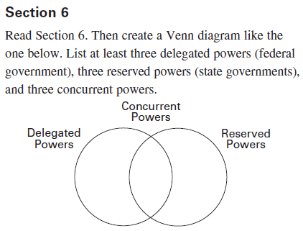
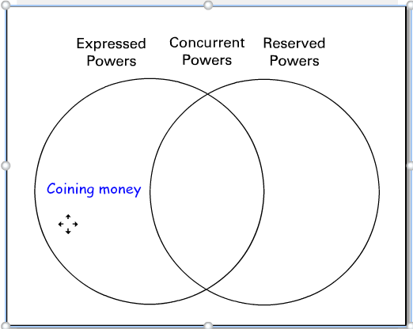
Venn review, Federalism

Slide 2
Mind Map, under “Federalism”
Expressed Powers
National government
Concurrent Powers
Shared
Reserved Powers
States and small gov’t

Slide 3
Federalism
The sharing of powers between the Federal Government and the State’s Governments
Both the states and the federal government’s duties and requirements are spelled out in the Constitution
What are the requirements for states?

Slide 4
Expressed, National Government Powers
Maintain Military
Declare War
Establish the Postal System
Weights and Measures
Protect patents and copyrights

Slide 5
Reserved, State’s Governmental Powers
Establish local government
Establish schools
Regulate State Commerce
Marriage regulations (overview)
Establish and regulate corporations

Slide 6
Concurrent, Shared Governmental Powers
Power to tax
Establish courts
Regulate banks
Borrow money
Provide for the general welfare

Slide 7
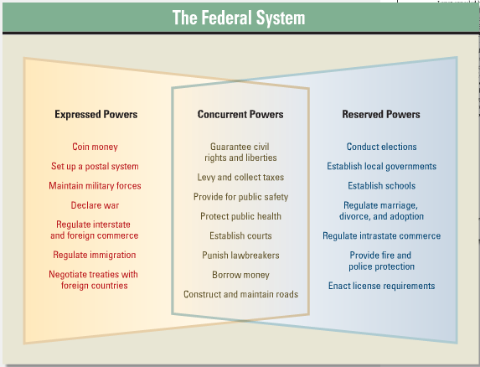
Venn Review

