Slide 1
The Rest of the ’70s: Carter (Ford did very little)
Energy Crisis
National Energy Act, Malaise Speech
Camp David Accords
Egypt gets land back that Israel took in 1967 (and kept in 1973) Wars
Iran Hostage Crisis
Let’s talk
Environmental Protection
Clean Water Act
Three Mile Island
Baby Bust
Rustbelt

Slide 2
Election of 1976
Democrat Nominee:
Jimmy Carter
Republican Nominee:
Gerald Ford
“I will never lie to the American people”
Election Day Results: Jimmy Carter wins with 40.8 million votes to Gerald Fords 39.1 million

Slide 3
Carter Presidency
Carter was the former governor of Georgia, but had no experience in Washington
Carter promised to restore honesty and new programs for energy development and national health care
Relaxed presidency
Deeply religious

Slide 4
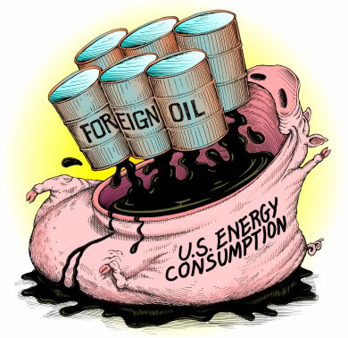
Carter Faces Problems
Energy Crisis: reliance on foreign oil
Creates Department of Energy
Passes the National Energy Act
Tries to lessen the crisis but none of the programs formed worked well

Slide 5
Economic Crisis
Violence in the Middle East produces fuel shortage in U.S.
Inflation rises from 7.6% to 11.3% in 1979, 14% in 1980
Standard of Living goes from 1st to 5th place in the word
Manufacturing jobs begin to decrease

Slide 6
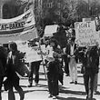
Civil Rights
His administration included more minorities and women than any other administration
Regents of California v. Bakke- upheld affirmative action, but race can’t be the deterring factor

Slide 7
Carter’s Foreign Policy
Promotes human rights throughout the world
1977 signed treaty that gave Panama the rights to the Panama Canal Dec 31, 1999
Will win Nobel Peace Prize for his efforts of world peace

Slide 8
Collapse of Detente
SALT II talks delayed
December 1979 Soviets invade Afghanistan
Carter places economic sanctions
Grain embargo
Carter lets SALT II die
U.S. boycotts 1980 Summer Olympics in Moscow

Slide 9
Iranian Hostage Crisis
Iran Crisis → originally, the US had supported the Shah, or ruler of Iran because they were a large supplier of oil to the US
Shah became an oppressive ruler and very unpopular among the people
The people forced him to flee in 1979
Ayatollah Khomeini → new ruler of Iran, greatly distrusted US
November, 1979 → revolutionaries stormed the American embassy and took 52 hostages

Slide 10
Iranian Hostage Crisis
Carter attempted a failed rescue attempted which ended with the death of 8 servicemen
The inability to free the hostages cost Carter the 1980 election
January 20, 1981 → day Carter left office, Iran released the hostages after 444 days in captivity

Slide 11
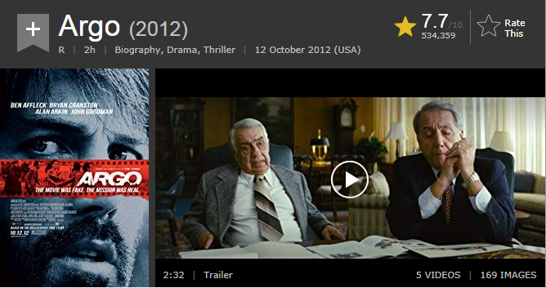
Iranian Hostage Crisis

Slide 12
Environmental Movement
Environmentalism grows
-Rachel Carson
Silent Spring, 1962
Wrote about pesticides and pollution of water and soil
-establishment of EPA
Environmental Protection Agency
Sets/enforces pollution standards
-April 22, 1970
1st Earth Day
Promotes ecological awareness

Slide 13
Environmentalism
Alaskan Conservation
Alaskan land set aside and given back to native tribes to save oil
-Nuclear Energy debate
Dangerous but convenient
Three Mile Island
- March 1979 near Harrisburg, PA
Partial meltdown showed dangers of nuclear power
-Continuing Movement
Struggle to balance environmental concerns with jobs and progress

Slide 14
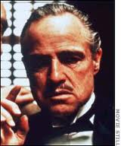
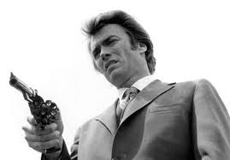
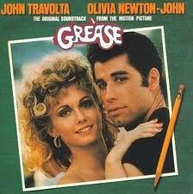
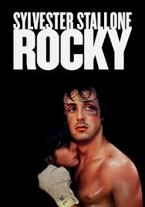
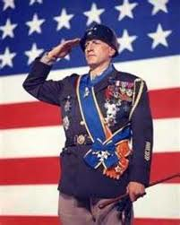
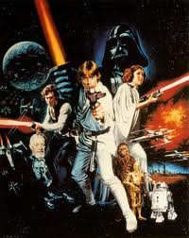

Slide 15
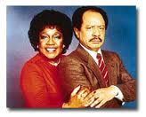
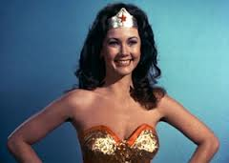
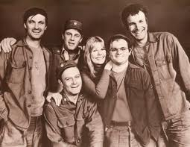
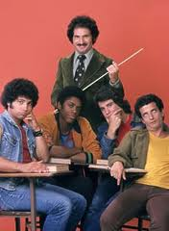
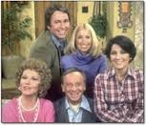
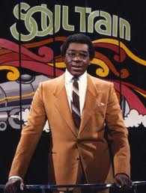
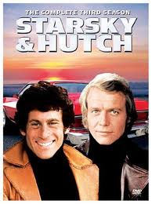

Slide 16
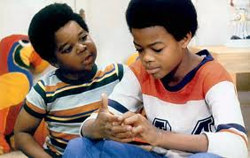
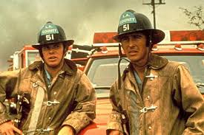
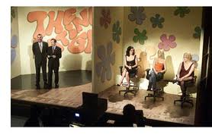
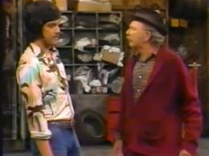
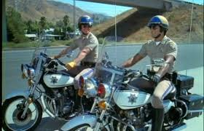
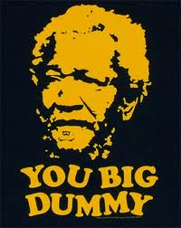

Slide 17
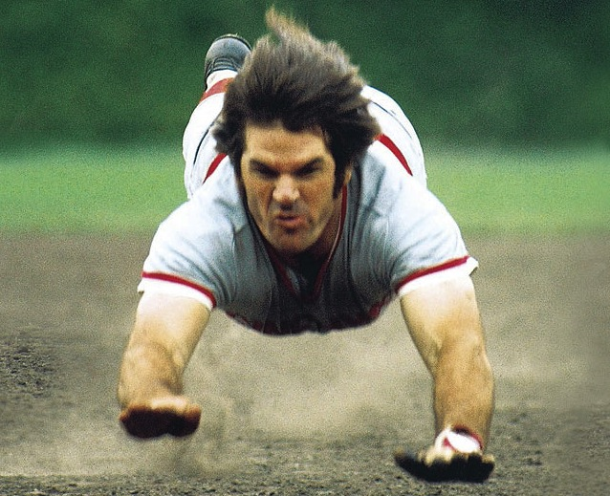
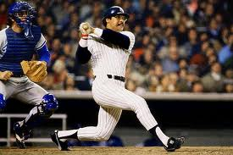
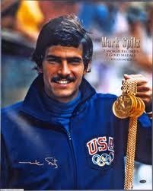
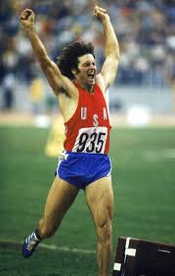
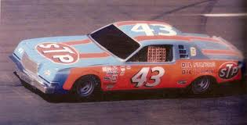
Sports Heroes
Bobby Orr
Pete Rose
Reggie Jackson
Franco Harris
Mark Spitz
Richard Petty
Bruce Jenner
Billie Jean King

Slide 18
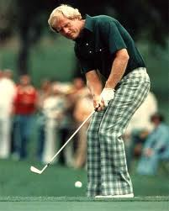
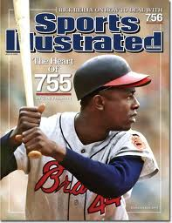
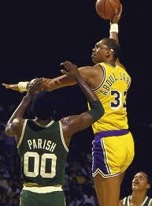
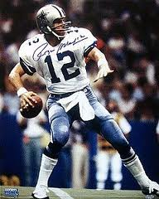
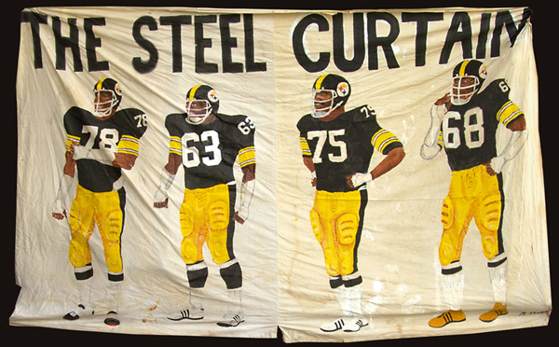
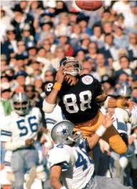
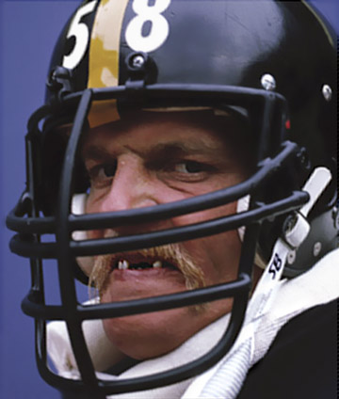
Sports Heroes
Jack Nicklaus
Dorothy Hamill
Hank Aaron
Kareem Abdul Jabbar
Roger Staubach
Team of 1970s

Slide 19
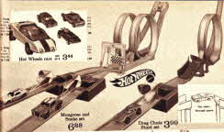

Slide 20
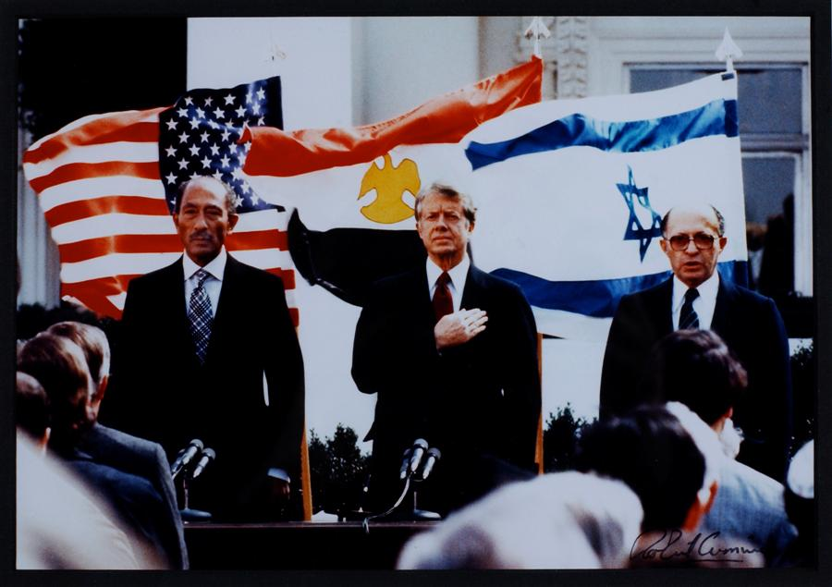
Camp David Accords 1979

Slide 21
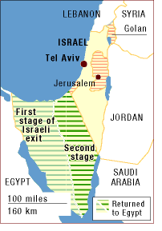
Camp David Accords 1979
Pres Carter
Egypt, Sadat
Israel, Rabin
*Israel gives up Sinai
*Egypt recognizes Israel as a country

Slide 22
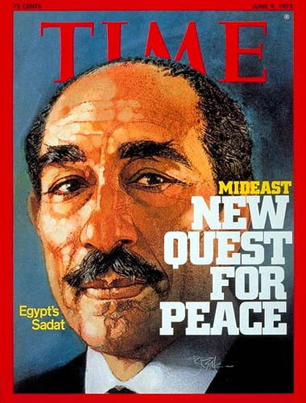
Anwar Sadat
President of Egypt
Makes peace with Israel

Slide 23
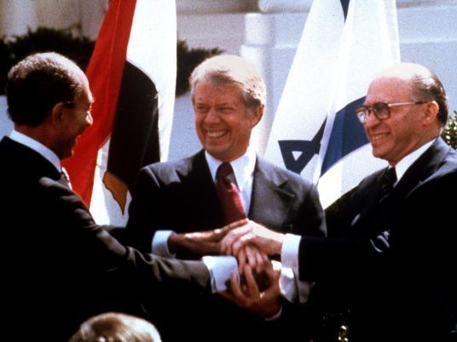
Egypt officially recognizes Israel’s existence.

Slide 24
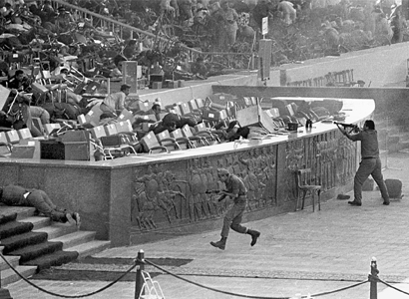

Slide 25
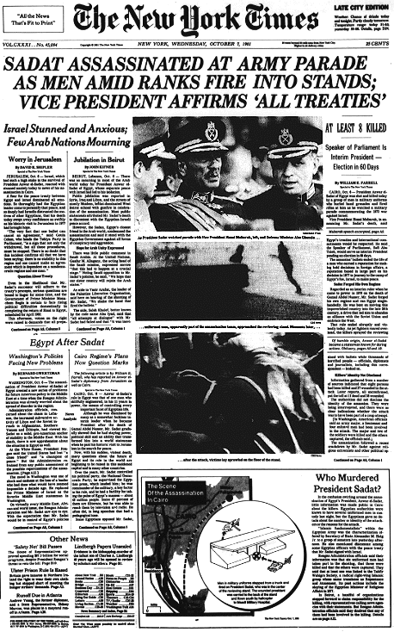

Slide 26
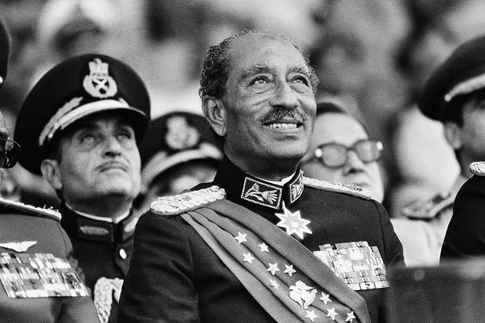
Sadat Assassinated
1981
Killed by Muslim Extremists angry over peace with Israel.

Slide 27
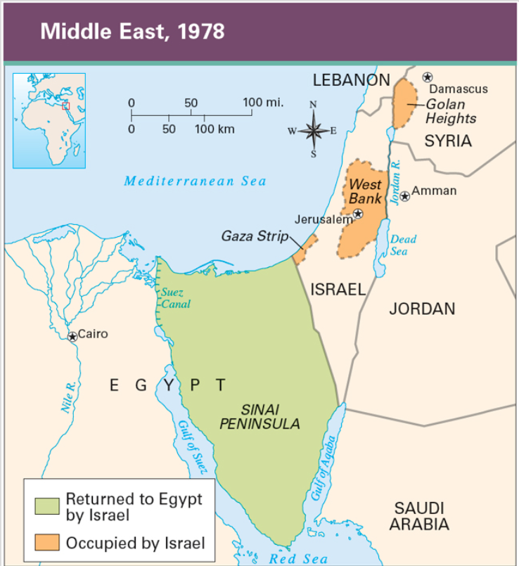
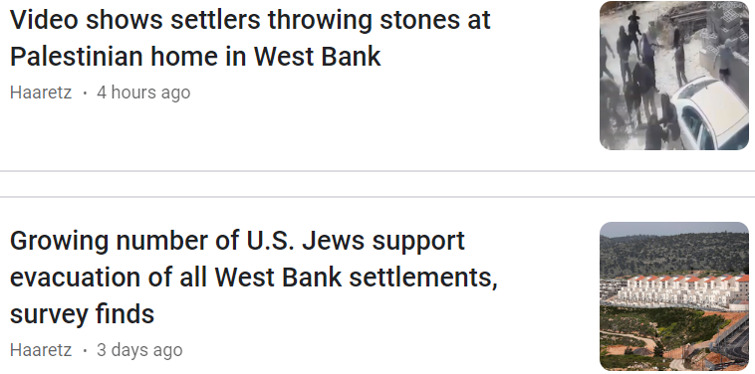
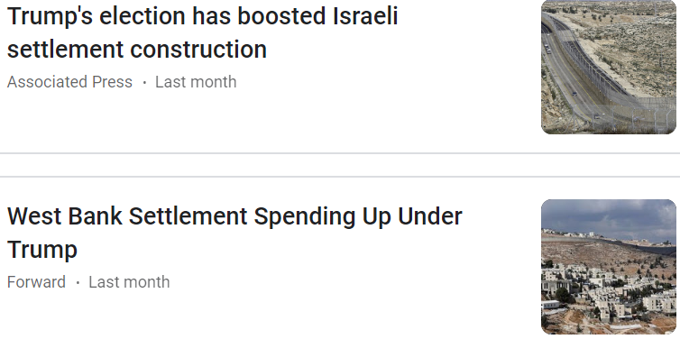

Slide 28
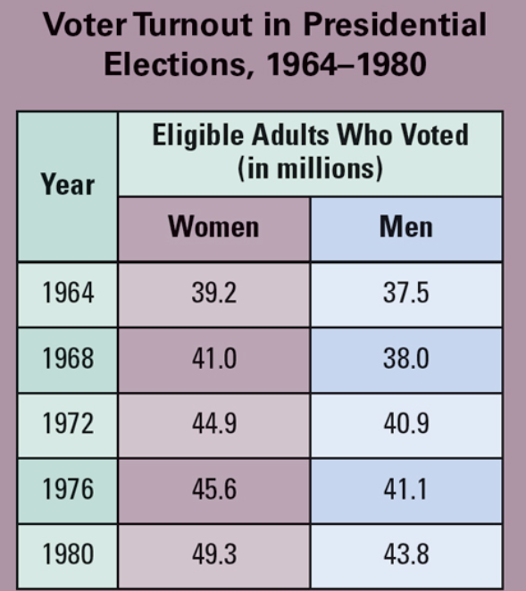

Slide 29
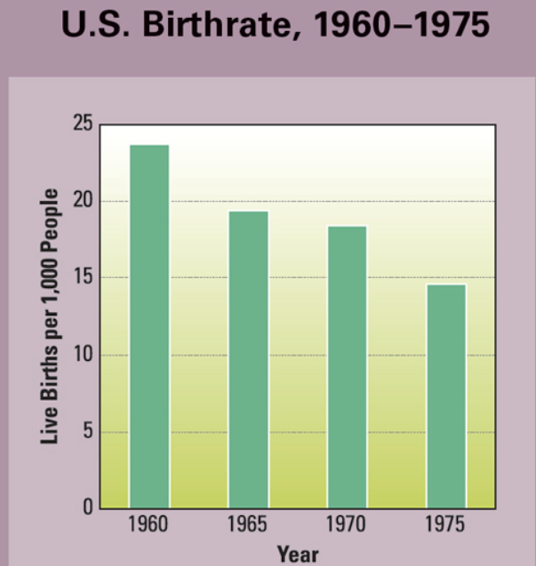
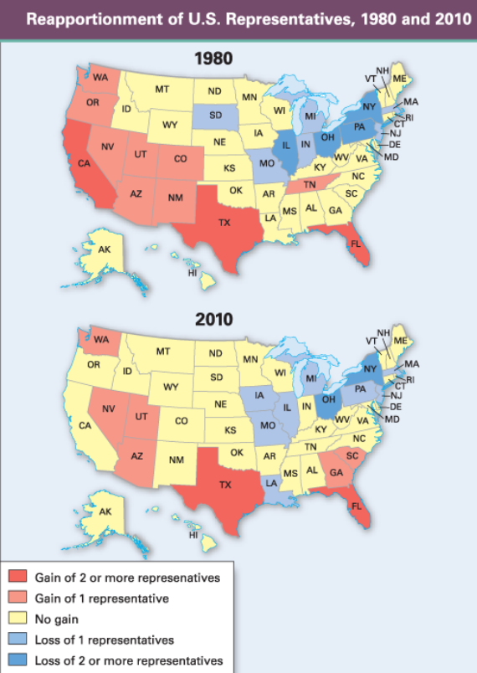

Slide 30
The Rest of the ’70s: Carter (Ford did very little)
Energy Crisis
National Energy Act, Malaise Speech
Camp David Accords
Egypt gets land back that Israel took in 1967 (and kept in 1973) Wars
Iran Hostage Crisis
Let’s talk
Environmental Protection
Clean Water Act
Three Mile Island
Baby Bust
Rustbelt

