Slide 1
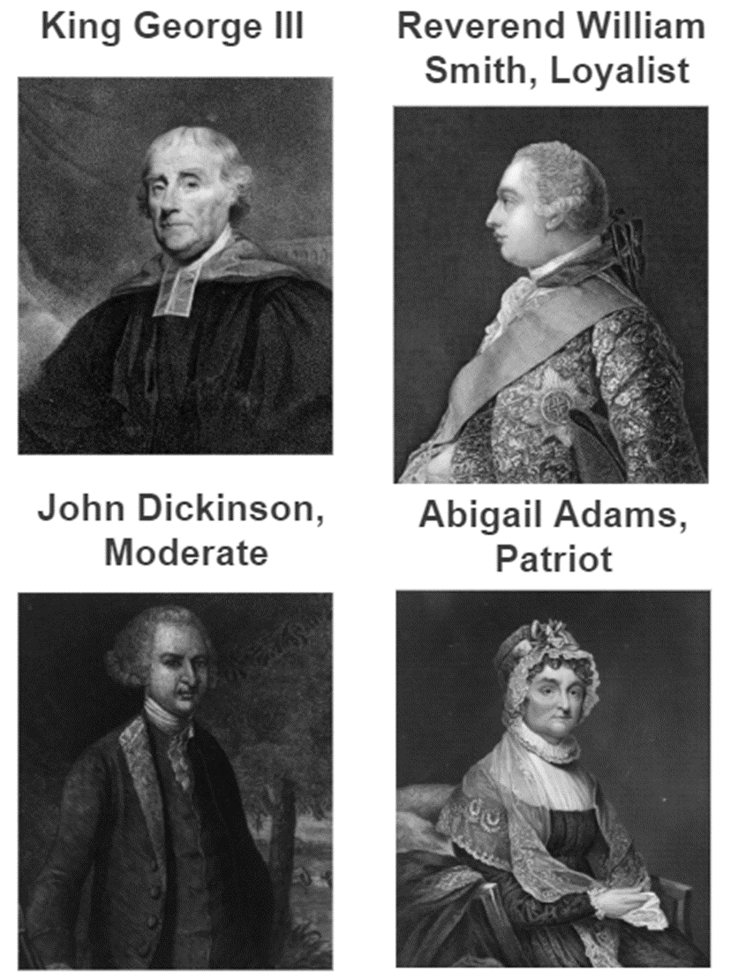
Primary Sources!
King George III
Abigail Adams
William Smith
John Dickinson

