Slide 1
Nixon Terms to Know for Sure
OHSA (Occupational Safety and Health Administration)
EPA (Environmental Protection Agency)
Energy Crisis: (OPEC punished the U. S. for its support of Israel)
Stagflation (prices and unemployment rise, wages don’t)
Détente: lower tensions between U. S. and China/USSR
SALT (Strategic Arms Limitation Treaty): limited nuclear weapons for U. S.-USSR
Watergate

Slide 2
New Federalism
Nixon’s program to reduce the federal gov’t role and put more emphasis on the state and local gov’t.
It called for revenue sharing in which the federal gov’t would give the state gov’t money for them to spend as they saw fit.

Slide 3
The Southern Strategy
Gain southern votes by supporting southern policies like getting the federal government out of desegregation issues
Nixon courts the Dixiecrats to gain more votes by trying to reverse Civil Rights Legislation
Swann v. Charlotte Mecklenburg- forced busing
bus students to enforce integration of schools
Nixon publicly disagreed didn’t enforce it.

Slide 4
The Economy
Stagflation → combination of inflation and a stagnant economy with high unemployment
Nixon had focused on controlling inflation by cutting spending and raising taxes
He then tried to reduce consumer spending by getting the Federal Reserve Board to raise interest rates

Slide 5
Causes of Stagflation
Inflation result of LBJ’s deficit spending on war, social programs
Unemployment from more international trade, new workers
Rising oil prices, U.S. dependence on foreign oil added to inflation

Slide 6
Oil Embargo
1973 OPEC countries are fighting the Yom Kippur War against Israel
US supports Israel
OPEC cuts off oil to the US causing prices to skyrocket
Prices went from 30 cents to 75 cents
Gas was rationed

Slide 7
Nixon Plan
Announced economic plan in August 1971:
Phase I froze wages and prices and rents for 90 days, devalued dollar in Dec.
Phase II eased controls on profits and dividends and fresh produce
Unemployment remained high but inflation began to decline.
Plan did not help

Slide 8
Realpolitik
Want U.S. to compete based on power not ideals; confront all powerful nations, even Communist
Henry Kissinger- Secretary of State was responsible for Nixon foreign policy

Slide 9
Nixon visits China (ping pong diplomacy!)
1972 Nixon becomes 1st U.S. president to visit China
He was visiting to work for normal relations with China
Open trade possibilities
Wanted to drive a wedge between China and Soviets
Give US better bargaining over nuclear weapons with Soviets
Wanted to isolate N. Vietnam

Slide 10
Detente
Easing of tensions between the U.S., China and the Soviets
The United States hoped to build a better relationship with its main rivals in the interest of world peace

Slide 11
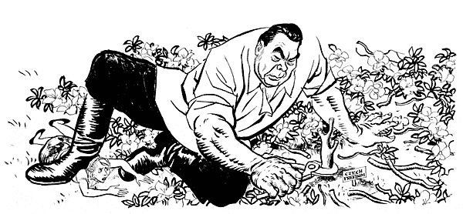
SALT I
May, 1972 → American-Soviet summit held to discuss the tensions between the Superpowers
Strategic Arms Limitation Treaty (SALT I) → plan to limit nuclear arms in both nations
Also agreed to increase trade and exchange of scientific information

Slide 12
Culture of Nixon Years
Pepsi Generation: era of restoration rather than protest, conservatism rather than reform, consumer culture rather than counterculture, detente rather than confrontation

Slide 13
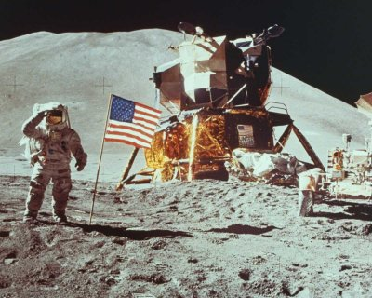
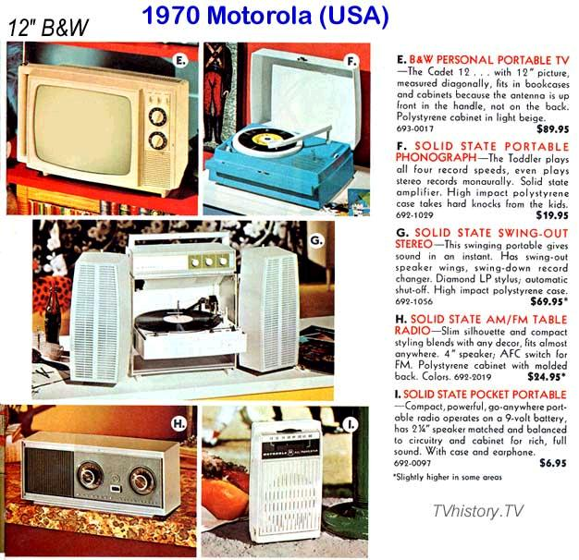
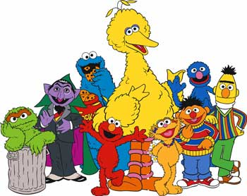

Slide 14
The Election of 1968
Richard Nixon only narrowly won the 1968 election, but the combined total of popular votes for Nixon and Wallace indicated a shift to the right in American politics.
The 1960s began as an era of optimism and possibility and ended in disunity and distrust.
The Vietnam war and a series of assassinations and crises eroded public trust in government and produced a backlash against liberal movements and the Democratic party.

Slide 15
1972 Election
Richard Nixon vs. George McGovern
George Wallace 3rd party candidate was shot
McGovern was associated with “Amnesty, Abortion & Acid”
Nixon promises peace at hand in Vietnam
Nixon wins in landslide

Slide 16
Watergate
What’s the big deal?

Slide 17
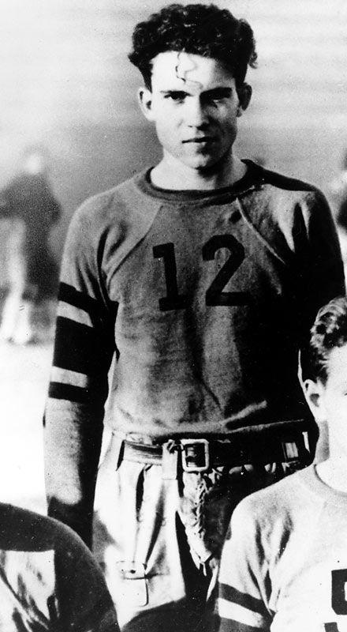
Don’t be “THAT GUY”
Listen to the teacher!
Or else, young, ruggedly handsome
Richard M. Nixon will hunt
you down!!

Slide 18
The Election of 1968
Richard Nixon only narrowly won the 1968 election, but the combined total of popular votes for Nixon and Wallace indicated a shift to the right in American politics.
The 1960s began as an era of optimism and possibility and ended in disunity and distrust.
The Vietnam war and a series of assassinations and crises eroded public trust in government and produced a backlash against liberal movements and the Democratic party.

Slide 19
The Election of 1968
Nixon campaigned as a champion of the "silent majority," the hardworking Americans who paid taxes, did not demonstrate, and desired a restoration of "law and order.”
He vowed to restore respect for the rule of law, reconstitute the stature of America, dispose of ineffectual social programs, and provide strong leadership to end the turmoil of the 1960s.

Slide 20
The Pentagon Papers
Beginning on June 13, 1971, the Times published a series of daily articles based on the information contained in the Pentagon Papers. After the third article, the U.S. Department of Justice got a temporary restraining order against further publication of the material, arguing that it was detrimental to U.S. national security. The Times and the Washington Post joined forces to fight the court battle, and on June 30 the U.S. Supreme Court ruled 6-3 that the government had failed to prove harm to national security, and that publication of the papers was justified under the First Amendment’s protection of freedom of the press.
In addition to publication in the Times, Post, Boston Globe and other newspapers, portions of the Pentagon Papers entered the public record when Senator Mike Gravel of Alaska, an outspoken critic of the Vietnam War, read them aloud in a Senate subcommittee hearing. These portions revealed that the presidential administrations of Harry S. Truman, Dwight D. Eisenhower,John F. Kennedy and Lyndon B. Johnson had all misled the public about the degree of U.S. involvement in Vietnam, from Truman’s decision to give military aid to France during its struggle against the communist-led Viet Minh to Johnson’s development of plans to escalate the war in Vietnam as early as 1964, even as he claimed the opposite during that year’s presidential election.

Slide 21
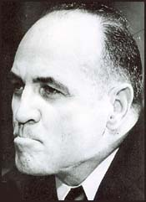
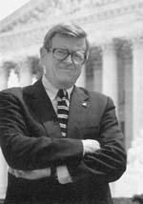
The White House Plumbers
What is it called when someone’s album is put online before the person intended to release it?
After the release of the Pentagon Papers, the White House created a unit to ensure internal security.
This unit was called the Plumbers because they stopped leaks.
In 1971 they burglarized the office of Daniel Ellsberg’s psychiatrist, seeking material to discredit him.
It was later revealed that Nixon’s domestic advisor John Ehrlichman knew of and approved the plan.
Howard Hunt
G. Gordon Liddy
James McCord
Chuck Colson

Slide 22
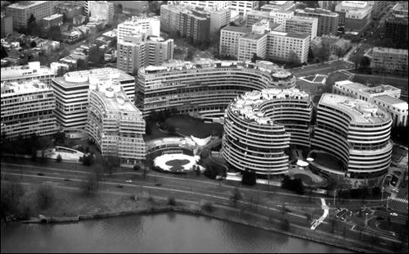
Watergate Hotel
Saturday Night Massacre

Slide 23
CREEP
Committee to Re-elect the President
$ for Nixon reelection campaign was used to try to cover-up the break in and silence the burglars
1973 the Senate begins investigation

Slide 24
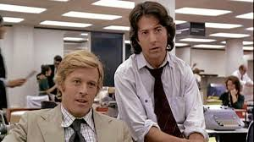
Woodward and Bernstein

Slide 25
Cover-Up Unravels
Watergate burglars went on trial and claimed that they were hired by the Nixon administration
John Dean, an inner circle member, testified that AG Mitchell ordered the break-in and that Nixon ordered the cover-up
Alleged tapes were discovered that recorded Nixon ordering the cover-up
Spiro Agnew (Nixon’s VP) was forced to resign because he was caught taking bribes → Gerald Ford becomes the new VP

Slide 26
The Tapes
Senate Judiciary Committee sues for tapes
Back and forth…smoke and mirrors!
U.S. v. Nixon forces Nixon to turnover tapes
Nixon claims Executive Privilege
Tapes come out…18 minutes is missing
Supreme Court orders “all tapes in their entirety”
Tapes prove Nixon knew and approved Watergate break in

Slide 27
Impeachment Begins
On 27 July 1974, the House Judiciary Committee approved Articles of Impeachment against Nixon.
The House was to vote on the matter soon.
Charges were obstruction of justice, abuse of power, perjury and contempt of Congress
Nixon conceded that impeachment in the House was likely, but he believed that the Senate vote to remove him would fail.

Slide 28
Nixon Resigns
On 5 August 1974, when the “smoking gun tape” became public, a delegation from the Republican National Committee told Nixon that he would not survive the vote in the Senate.
On 9 August 1974, Richard Nixon became the first American president to resign.

Slide 29
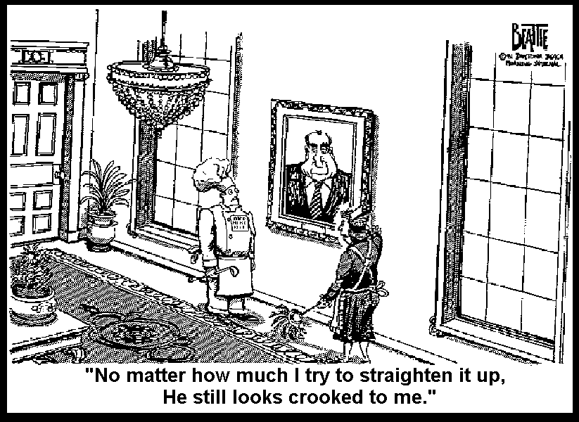

Slide 30
Aftermath
More than 30 government officials went to prison for their role in Watergate.
Richard Nixon was not one of them.
In September 1974, President Gerald Ford gave Nixon a full pardon.
America became very distrustful of the Presidency
Woodward and Bernstein won the Pulitzer Prize.
They collaborated on 2 books, All the President’s Men and The Final Days.
In 1976 All the President’s Men was adapted into an Oscar winning film.
The identity of Deep throat was kept secret until W. Mark Felt unmasked himself in 2005.

Slide 31
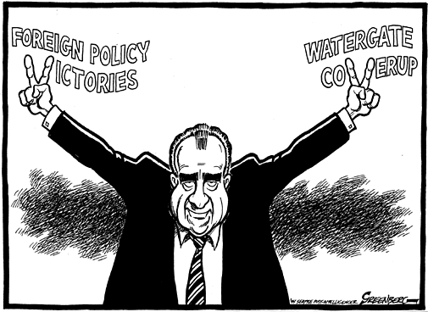
In sum,

Slide 32
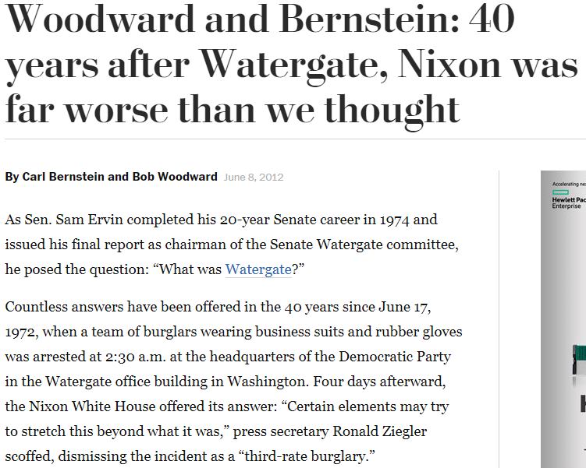

Slide 33
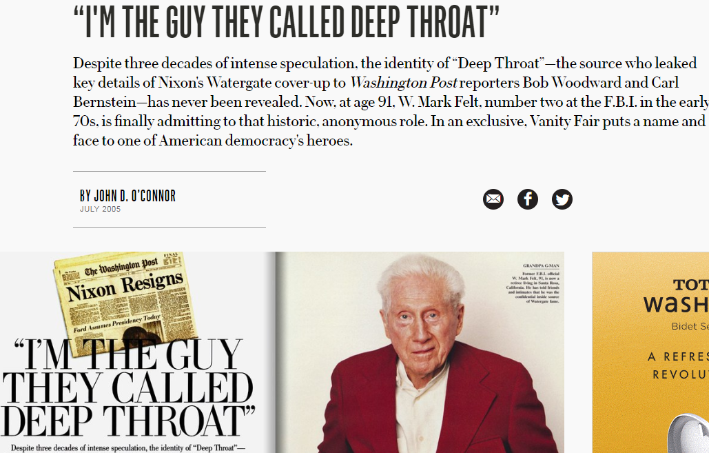

Slide 34
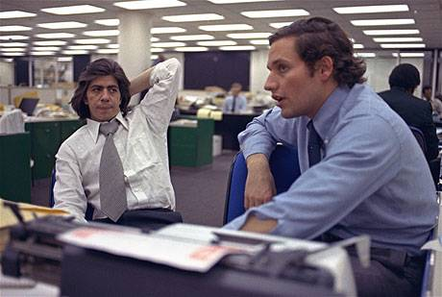
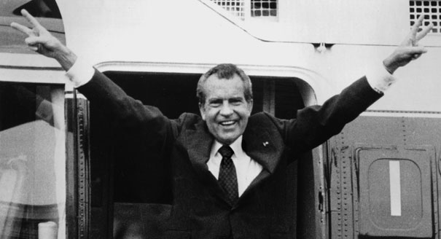
Summary Questions
What happened at the Watergate hotel in 1972?
Why is it so damaging to President Nixon’s legacy?
Why is it such a big deal?
What should have happened to those involved?
What was the role of the media?
What, likely, would have happened with this whole Watergate situation is Woodward and Bernstein had not pursued the story?
How might this event have influenced future journalists?

Slide 35
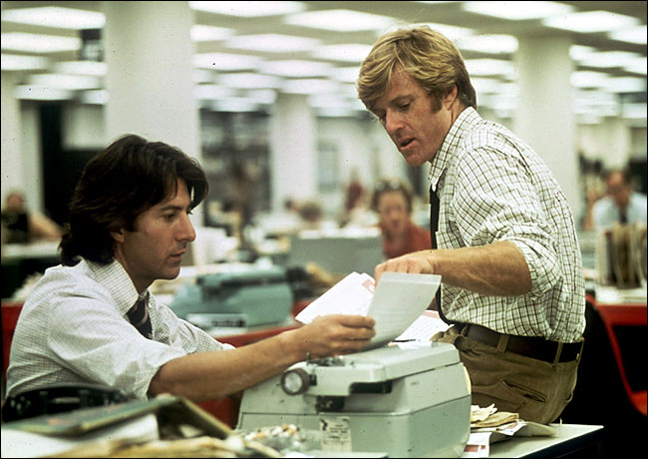
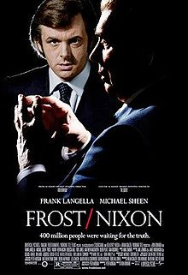
If this thing intrigues you..
All the President’s Men (1976)
Dick (1999)
Frost/Nixon (2008)

