Slide 1
Review
Why would nations use appeasement toward Germany in the early 1940s?
What impact would appeasement have on an aggressor nation?
What prevented the United States from getting involved in the European conflict in the early 1940s?
What are some costs and benefits of America’s action/inaction?

Slide 2
Things to remember
The Treaty of Versailles was horribly punitive toward Germany
The WORLD was in a Great Depression
Hitler was elected democratically
Austria was annexed by a vote
The Sudetenland was given to Germany
Mussolini was more overt dictator
No knowledge of death camps

Slide 3
Terms
Neutrality Acts
Cash and Carry
Belligerent
Aggressor

Slide 4
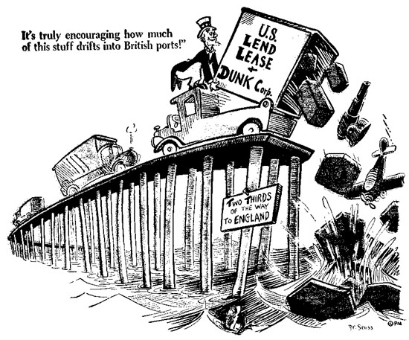
Lend-Lease Act and the Political cartoons of Dr. Seuss
Power point created by Robert L. Martinez
Primary Content Source: Living History America, edited by E. Bruun and J. Crosby.
Images cited as listed.
http://orpheus-1.ucsd.edu/speccoll/dspolitic/Frame.htm

Slide 5
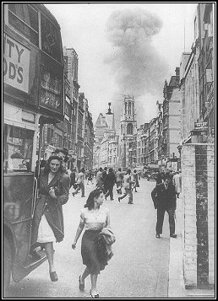
During World War II, with England standing alone against Germany in Europe, Hitler began a daily bombing blitz of England.

Slide 6
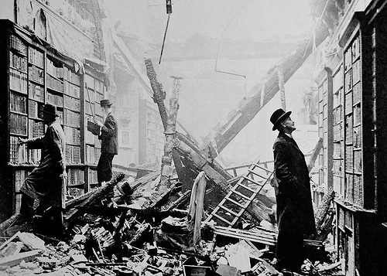
http://www.flickr.com/photos/phodgepage/2408512430/

Slide 7
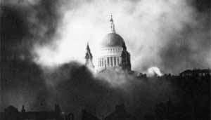
http://www.wwwk.co.uk/50s

Slide 8
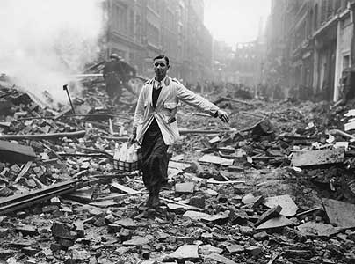
http://www.flickr.com/photos/forpaws/2664298946/

Slide 9
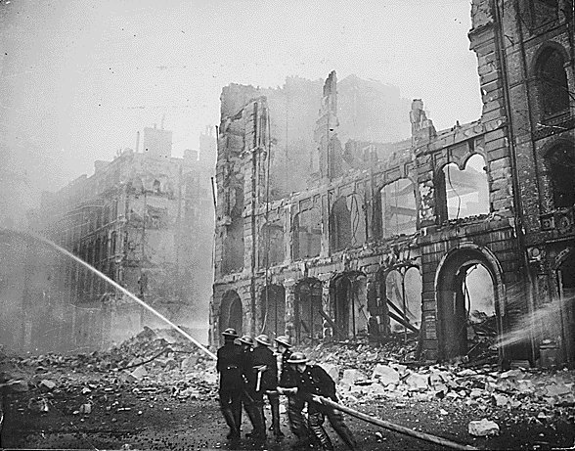
www.uncp.edu

Slide 10
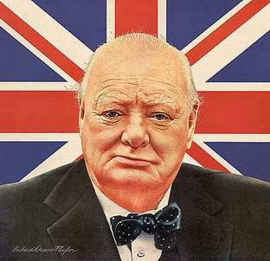
Desperate for supplies to protect England, British Prime Minister Winston Churchill implored Roosevelt for assistance to fight off Germany’s expected invasion.
Winston Churchill
http://www.rainbowkids.de/projekte_und_infos/schuelerseite/Referate/NGemmerich/winston_churchill.htm

Slide 11
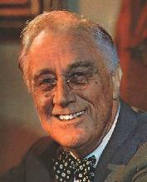
By early 1941, President Franklin Roosevelt had no doubt that the U.S. needed to throw its support behind England.
Why?
http://www.clockworkquiz.be/online/page.cfm?cat=5§ionorder=0

Slide 12
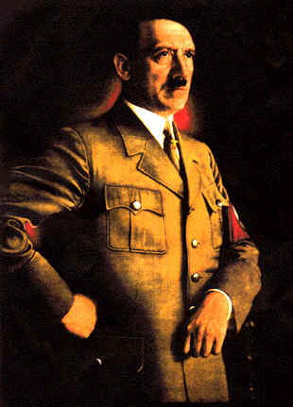
Even though sympathies were starting to sway, their was still a strong isolationist sentiment in the United States.

Slide 13
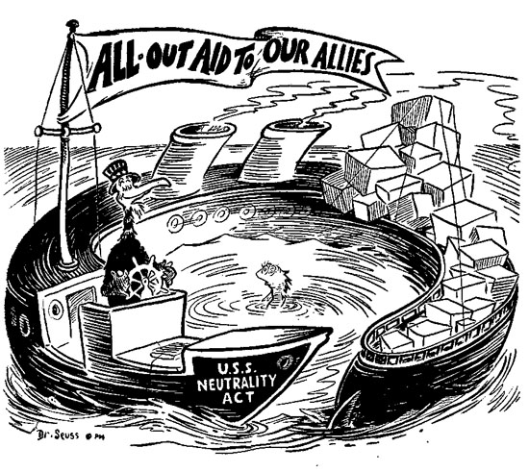
Congress had passed the Neutrality Acts to keep America neutral during the WWII conflict.
http://orpheus-1.ucsd.edu/speccoll/dspolitic/Frame.htm

Slide 14
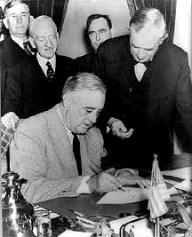
Roosevelt had to find a way to provide supplies to Churchill and still skirt the objections of isolationists.
http://www.classbrain.com/artteenst/publish/article_83.shtml

Slide 15
How did Roosevelt’s
Wishes differ from
That of the American
Public?

Slide 16
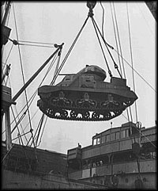
Roosevelt came up with the Lend-Lease Program. In exchange for the lease of some British islands in the Caribbean Sea, the U.S. provided England with ships and munitions.
http://edsitement.neh.gov/view_lesson_plan.asp?id=769

Slide 17
Technically skirting the Neutrality laws, Congress passed the Lend-Lease Act in March 1941 after a bitter debate.
http://orpheus-1.ucsd.edu/speccoll/dspolitic/Frame.htm

Slide 18
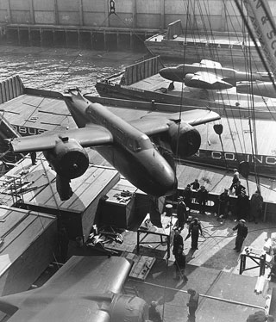
Roosevelt had found a way to assist the English people. The Lend-Lease Act provided crucial military supplies for Great Britain’s fight against Nazi Germany.
http://www.archives.gov/historical-docs/todays-doc?dod-date=311

Slide 19
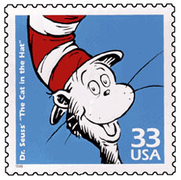
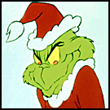
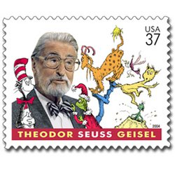
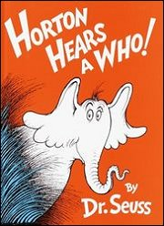
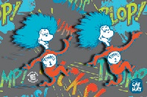
Before writing and illustrating his famous children’s books, Dr. Seuss spent a long career as a political cartoonist.
http://www.thebestlinks.com/Dr._Seuss.html

Slide 20
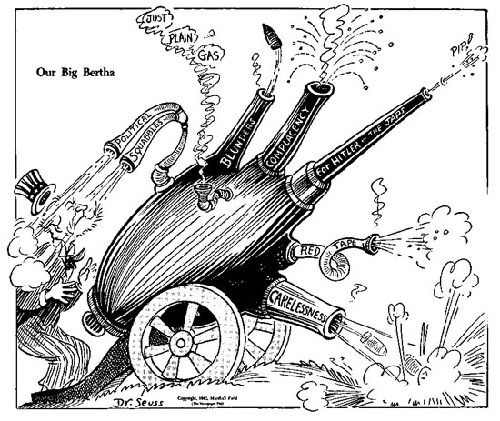
What do Dr. Seuss’s illustrations convey about American neutrality?
http://orpheus-1.ucsd.edu/speccoll/dspolitic/Frame.htm

Slide 21
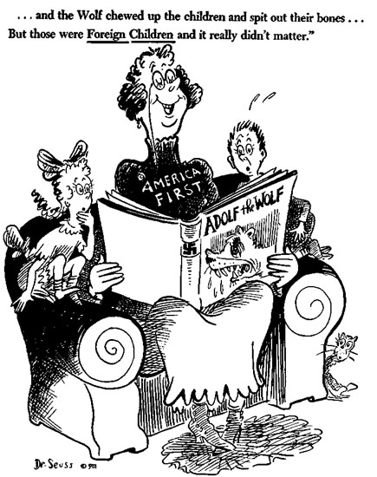
“…and the Wolf chewed up the children and spit
out their bones…But those were Foreign Children
and it really didn’t matter.”
http://www.memepool.com/Author/kapital

Slide 22
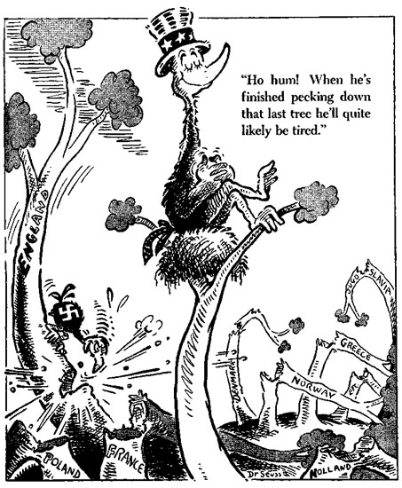
“Ho hum! When he’s finished pecking down
that last tree he’ll quite likely be tired.”
http://sixmeatbuffet.com/archives/2007/03/02/dr-seuss-birthday

Slide 23
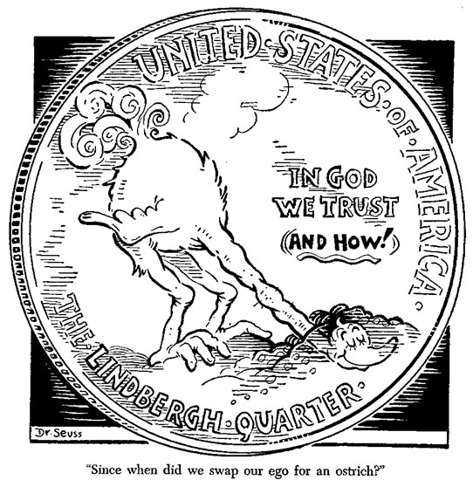
“Since when did we swap our ego for an ostrich?”
http://orpheus-1.ucsd.edu/speccoll/dspolitic/Frame.htm

Slide 24
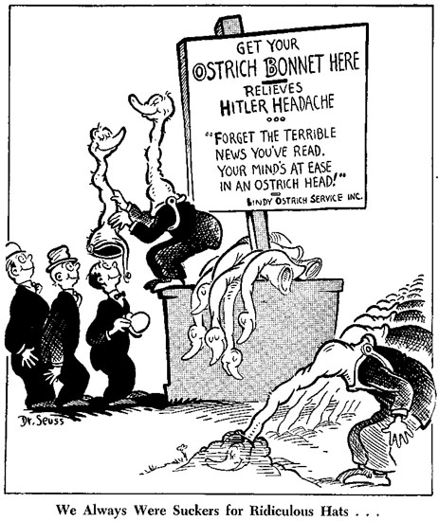
“Forget The Terrible
News You’ve Read.
Your Mind’s at Ease
In an Ostrich Head!”
“We Always Were Suckers for Ridiculous Hats…”
http://www.coxandforkum.com/archives/001092.html

Slide 25
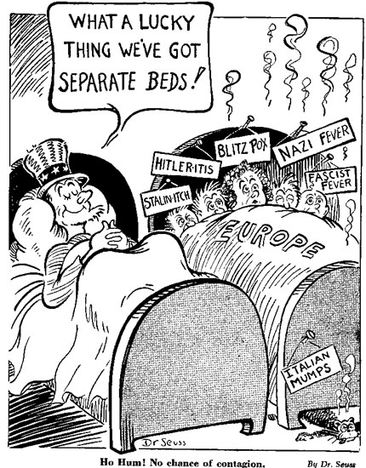
http://www.coxandforkum.com/archives/001092.html

Slide 26
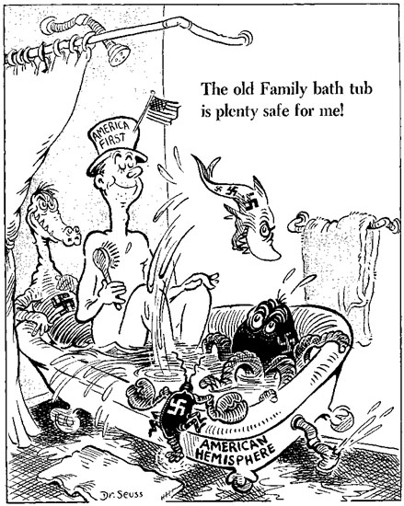
“The old Family bath tub is plenty safe for me!”
http://orpheus-1.ucsd.edu/speccoll/dspolitic/Frame.htm

Slide 27
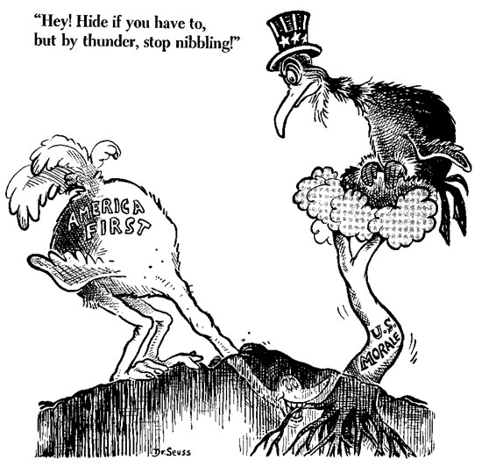
“Hey, Hide if you have to, but by thunder, stop nibbling!”
http://orpheus-1.ucsd.edu/speccoll/dspolitic/Frame.htm

Slide 28
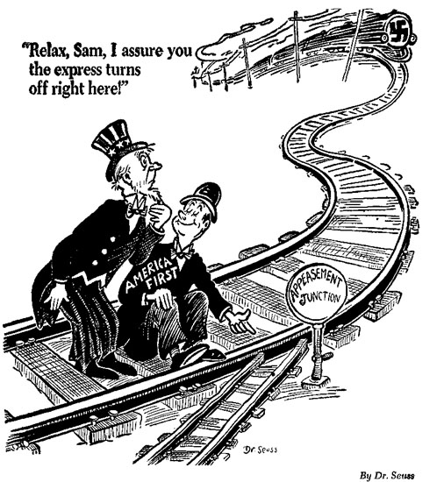
“Relax, Sam, I assure you the express turns off right here!”
http://www.coxandforkum.com/archives/001092.html

Slide 29
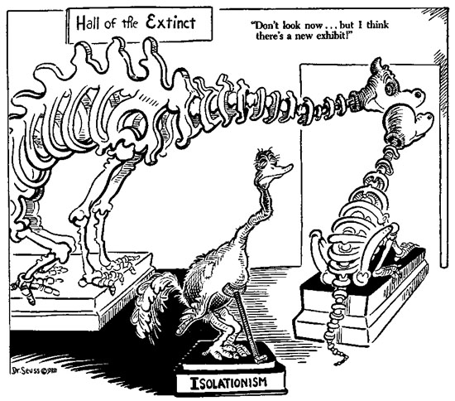
“Don’t look now…but I think there’s a new exhibit!”
http://www.coxandforkum.com/archives/001092.html

Slide 30
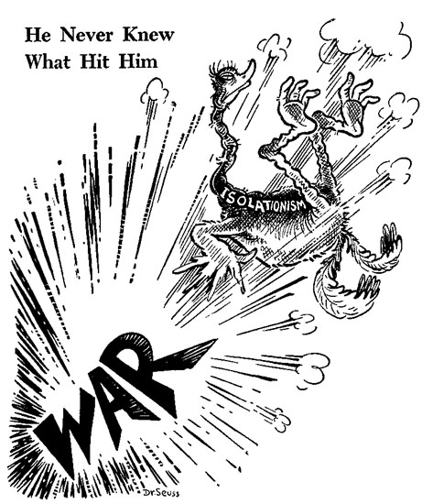
“He Never Knew What Hit Him”
http://www.coxandforkum.com/archives/001092.html

Slide 31
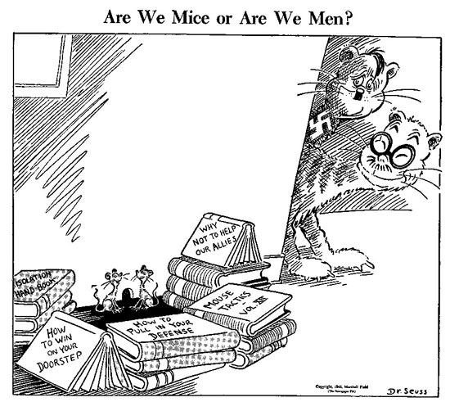
“Are We Mice or Are We Men?”
http://orpheus-1.ucsd.edu/speccoll/dspolitic/Frame.htm

Slide 32
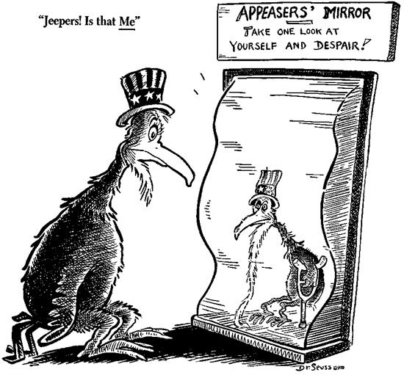
“Jeepers! Is that Me”
http://orpheus-1.ucsd.edu/speccoll/dspolitic/Frame.htm

Slide 33
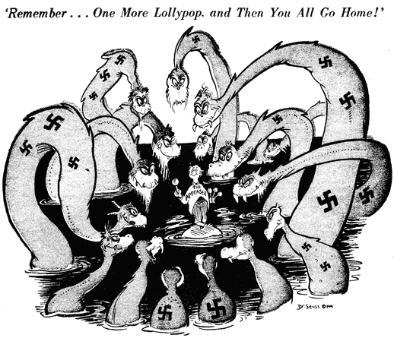
“Remember…One More Lollypop,
and Then You All Go Home!”
http://www.coxandforkum.com/archives/001092.html

Slide 34
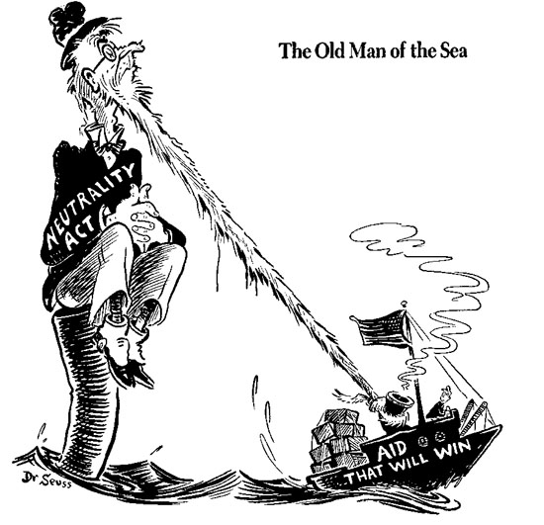
http://orpheus-1.ucsd.edu/speccoll/dspolitic/Frame.htm

Slide 35
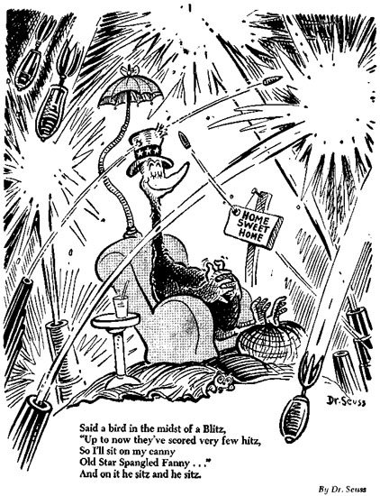
“Said a bird in the midst of a Blitz, ‘Up to now they’ve scored very few hitz, So I’ll sit on my canny Old Star Spangled Fanny…’And on it he sitz and he sitz.”
http://orpheus-1.ucsd.edu/speccoll/dspolitic/Frame.htm

