Slide 1
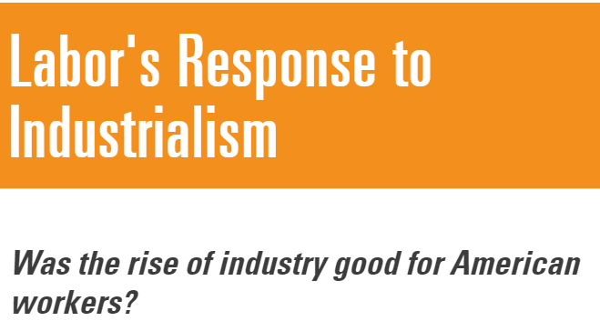

Slide 3
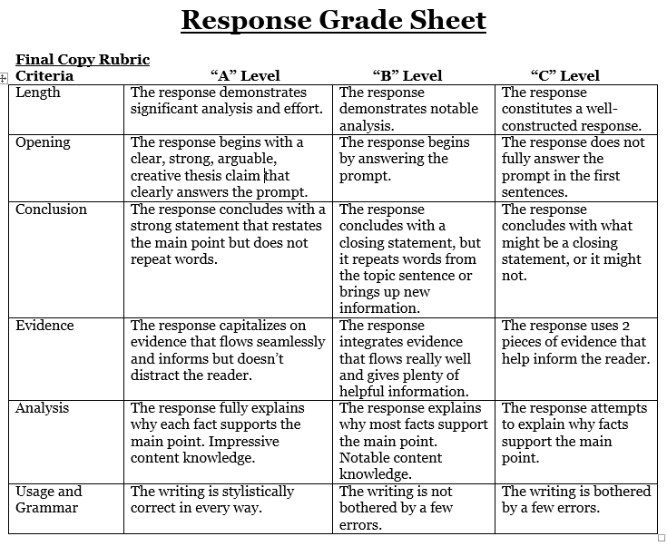
Response
3 pieces of evidence

Slide 4
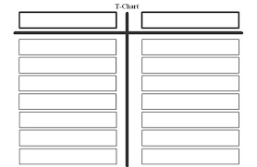
T-chart: industrialization good and bad
Go for 20 pieces of info
Main points: save space after each for
Evidence: use ch 13 graphs and questions, ch 14 notes, Crash Course, my lecture, and further research after each main point. Be specific!

Slide 5
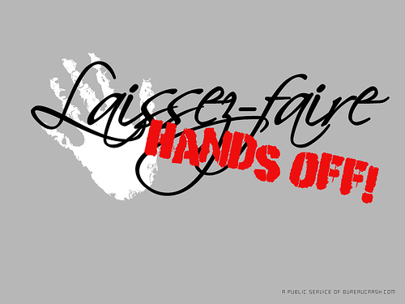
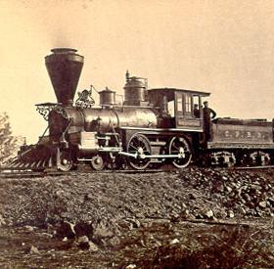
6 Reasons for Industrialization
1) Laissez Faire- Econ philosophy = Gov’t hands off business (actually gov’t promoted industry)
2) High protective tariff- Protects industry / foreign products more $$$$- knocks out competition – (workers pay more)
3) Improved Railroads – 30,000 miles – 193,000 miles (1860 -1900)

Slide 6
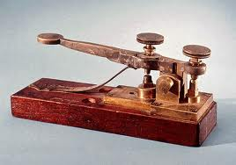
6 Reasons for Industrialization
4) New Technology – Steel / air brakes/ refrigeration, telegraph, telephone, electricity, typewriter, mass production
5) Growth of cities- (steel/electricity public utilities)
6) New forms of business – corporation, trusts

Slide 7
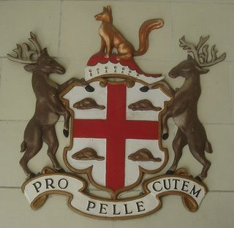
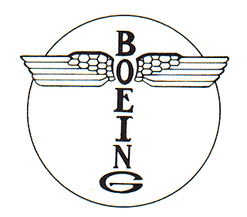
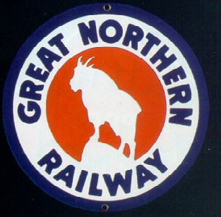
The Corporation
A form of business organization that became increasingly popular during the Industrial Revolution
As businesses got bigger, it took larger and larger amounts of CAPITAL ($$) to start such a business
3 major advantages of a corporation:
Can raise money through the sale of STOCK – shares of ownership in the corporation
Limited Liability – stockholders are not liable for debts of the corporation larger than what they have already invested
Immortality – Corporations outlive their individual owners

Slide 8
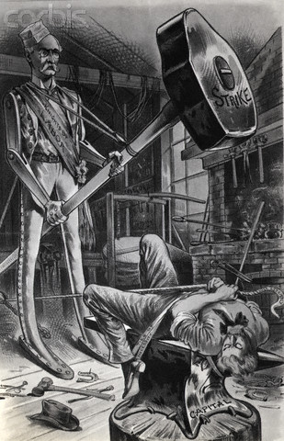
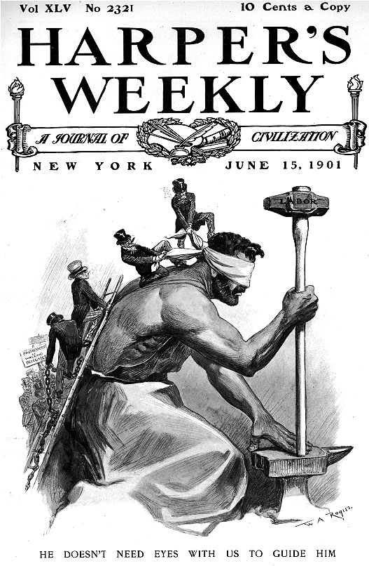
Labor and Unions-The Beginning
Bloodiest labor history in the world!
VS.

Slide 9
Labor Union
A group of workers who join together to try to get better conditions on the job
Wages
Hours
Safety
Security
Benefits

Slide 10
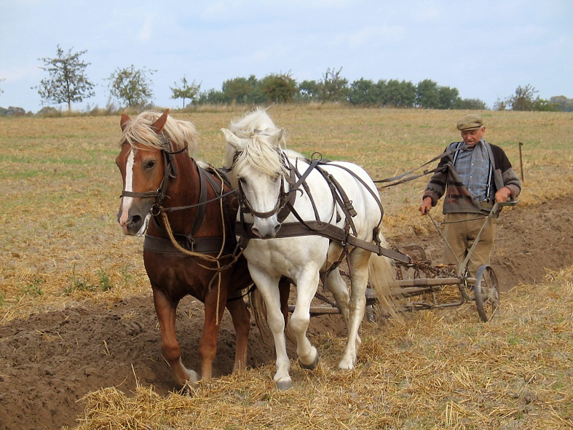
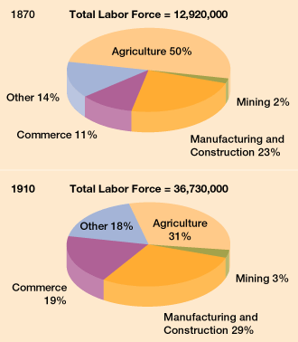
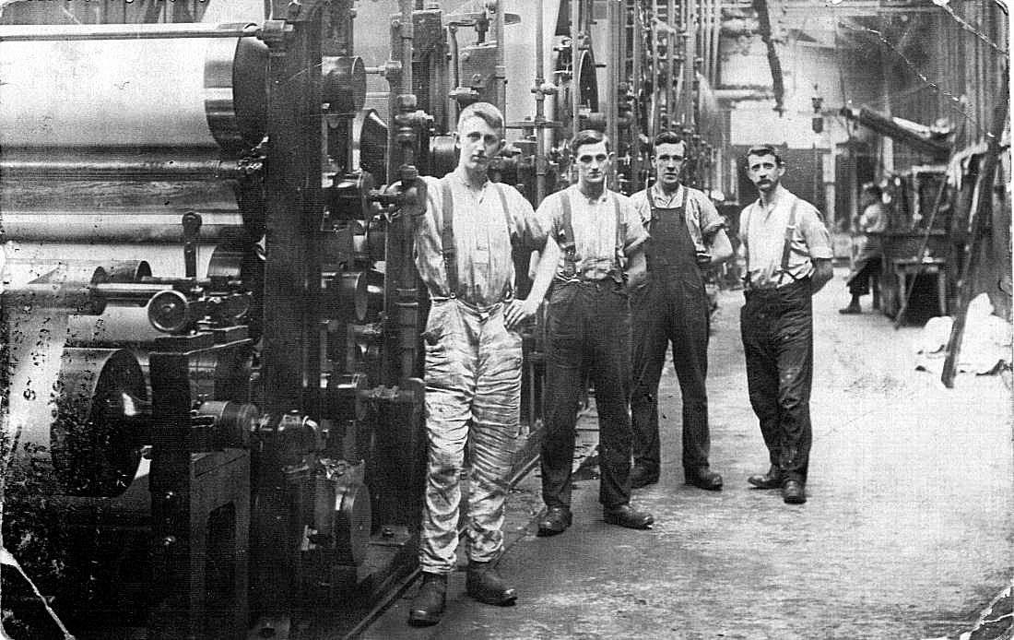
The Changing American Labor Force

Slide 11
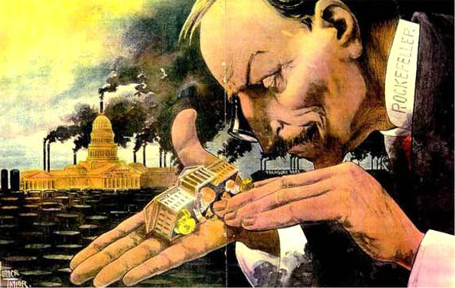
Working Conditions: Turn of the century

Slide 12
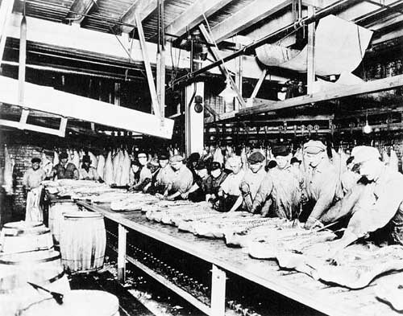
Working Conditions
Factory life
Low wages / repetitive work
high industrial accident rate
Unhealthy workplaces
no safety nets
Loss of skilled labor in workforce

Slide 13
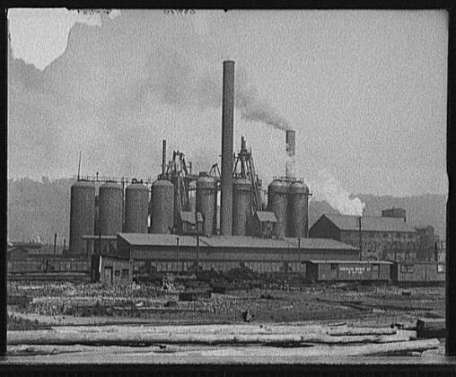
Example of Working conditions
Carnegie Steel – 1 week 12 hours a day
Next week 12 hour nights
A 24 hr. swing shift with every other Sunday, Xmas, & July 4th off.

Slide 14
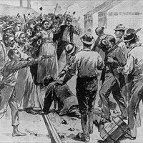
Labor Facts
35,000 workers killed annually on the job in 1890s
1 million injuries a year
$1.25 to $1.50 a day unskilled (skilled – double that amount)
Women/ children much less
Most worked 10 hours a day – 6 days a week
$600 needed for family to survive- unskilled earned under $500 a year for 3100 hours of work

Slide 15
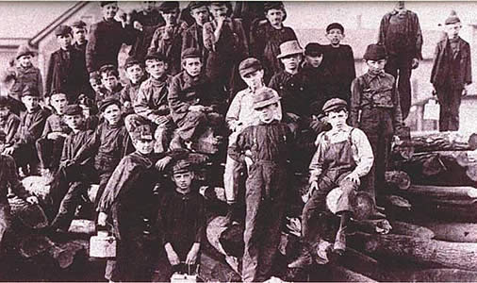
American Views that hurt Labor
Supply & Demand --Too much labor- could pay little & if you complain- 10 others waiting for your job
Work hard & you can get your dreams
Social Darwinism
Fear/ racism against foreigners/ blacks – most unskilled workers
Fear revolution of poor
Foreigners/ blacks & pos-
sible chaos / anarchy

Slide 16
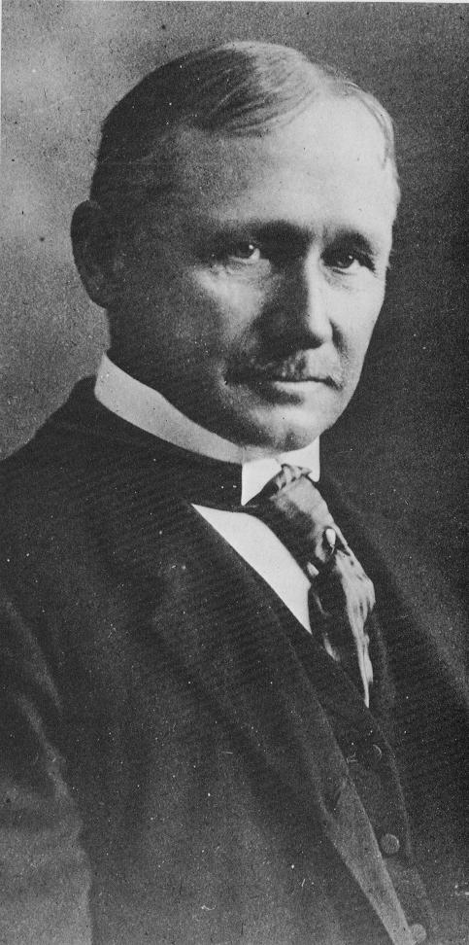
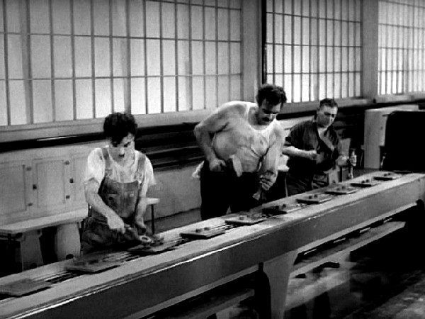
Assembly Line
Frederick Winslow Taylor
“Scientific Management”

Slide 17
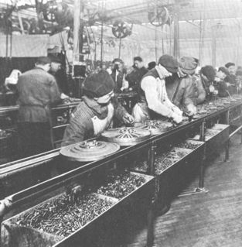
Workers put spokes on the wheels of a future car.

Slide 18
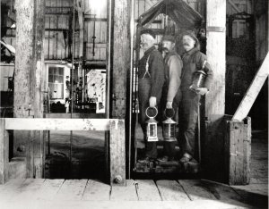
3 miners waiting to use the primitive elevator to lower them into the mining shaft for a days work!

Slide 19
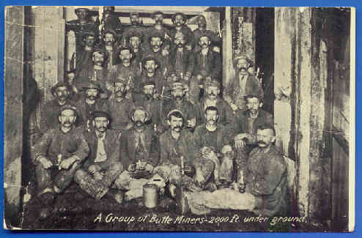
A group of miners pose for a picture……. 2000 feet underground!!!!! That is almost ½ of a mile!

Slide 21
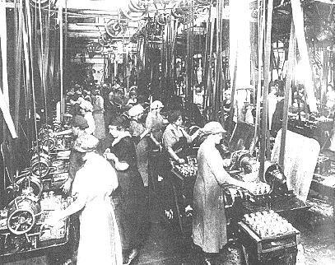

Slide 22
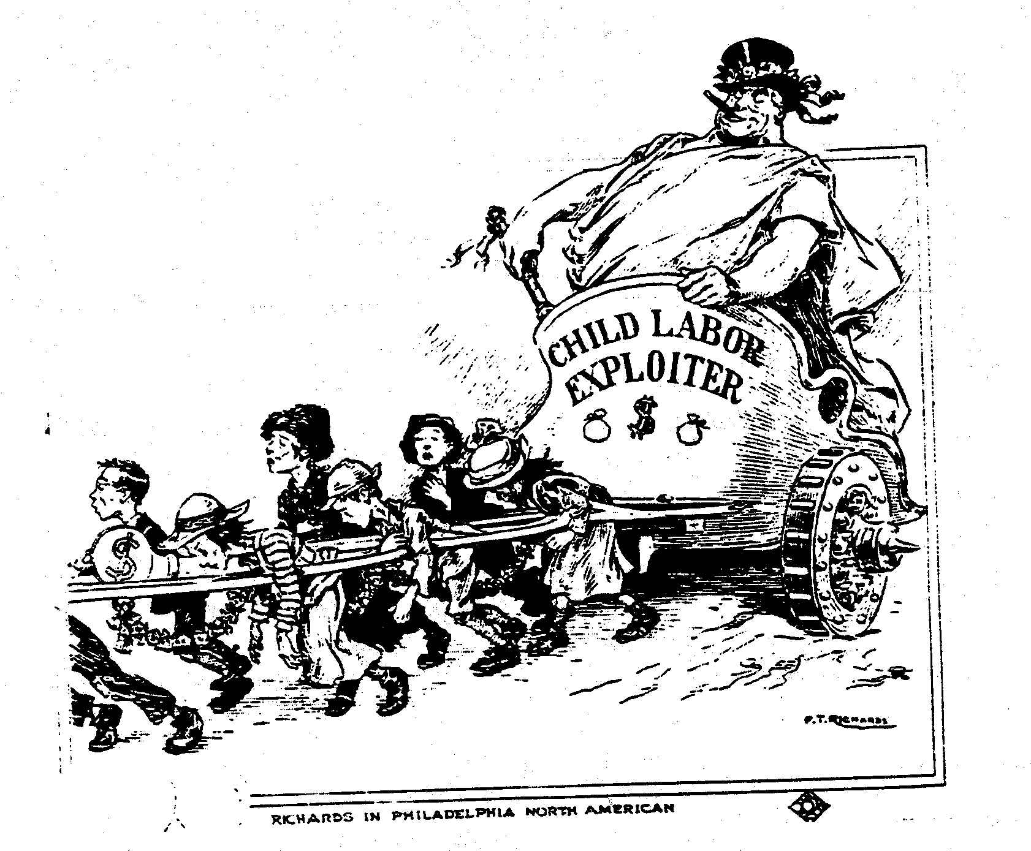
How is Big Business treating its workers according to the picture?

Slide 23
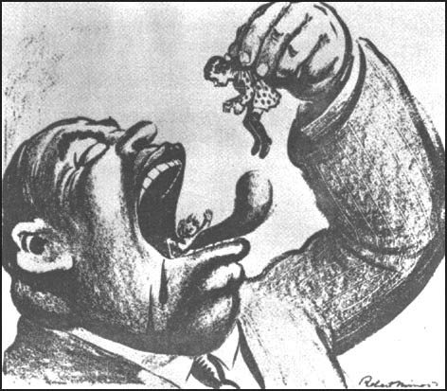
Child Labor

Slide 25
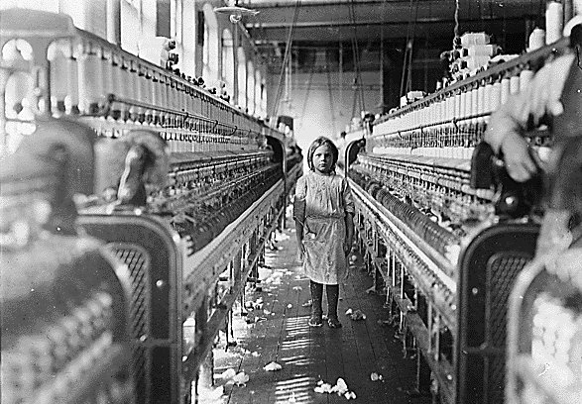
Here is a SIX year old girl working in a cotton mill

Slide 26
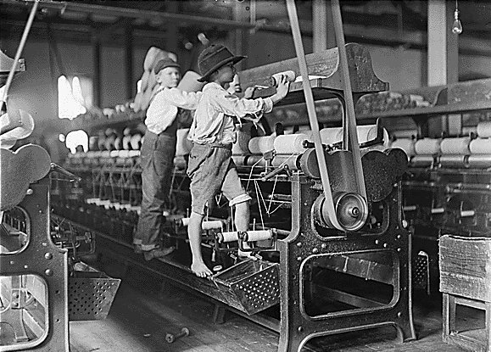
Children stand on the machine while it is in motion

Slide 27
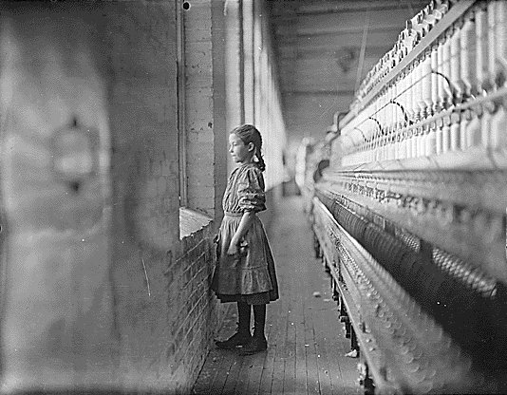

Slide 28
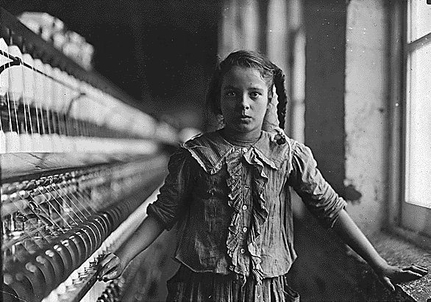
Look carefully, what is missing?

Slide 29
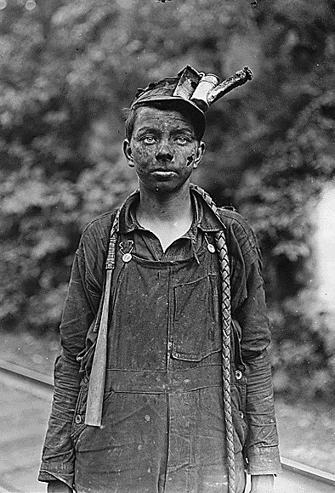
What occupational (job) hazards can you find in this picture?
A candle would be placed into his hat to provide light while working in the mines!

Slide 30
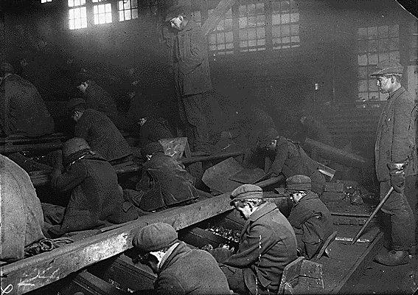
The taller boy standing to the right oversees the breaker boys who separate the coal from the stones during mining. The machine used is moving quickly and they are not allowed to wear gloves! Why might this be dangerous?

Slide 31
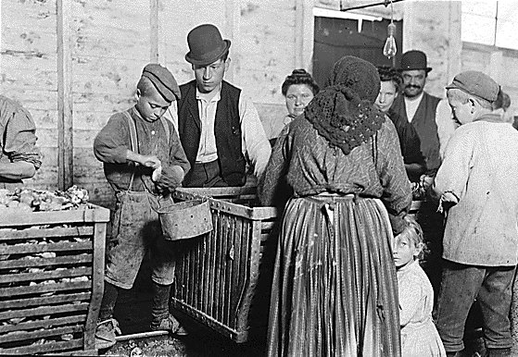
Mom and children working together in the seafood industry!

Slide 32
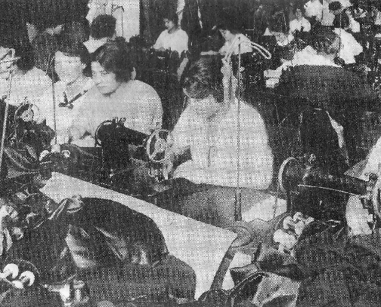
Women sewing in a garment factory.

Slide 33
Women in the Workplace

Slide 34
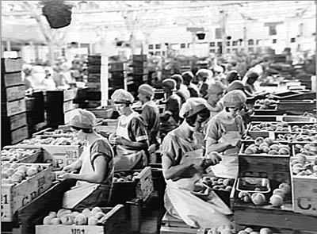
Women canning fruits in order to preserve them.

Slide 35
Child Labor

Slide 36
Bobbin Boys

Slide 37
Boy Miners

Slide 38
Tenement- House Slums- very crowded housing for workers and families during industrialization. Cities were covered with this kind of housing!

Slide 39
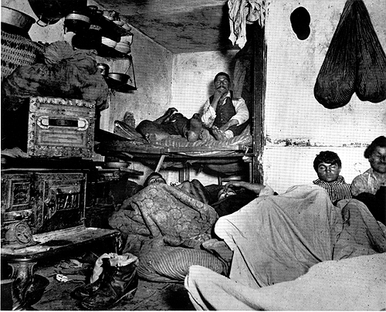
Inside a tenement house!

Slide 42
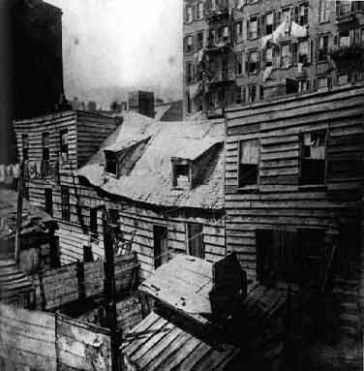
Another view of a tenement housing complex!

Slide 43
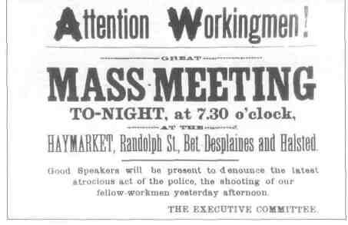
What actually happens?
LABOR MOVEMENT IN THE UNITED STATES TAKES PLACE!!!

Slide 44
Knights of Labor

Slide 45
Management vs. Labor
“Tools” of Management
“Tools” of Labor
“scabs”
Pinkertons
lockout
blacklisting
yellow-dog contracts
Collective Bargaining
informational picketing
organized strikes

Slide 46
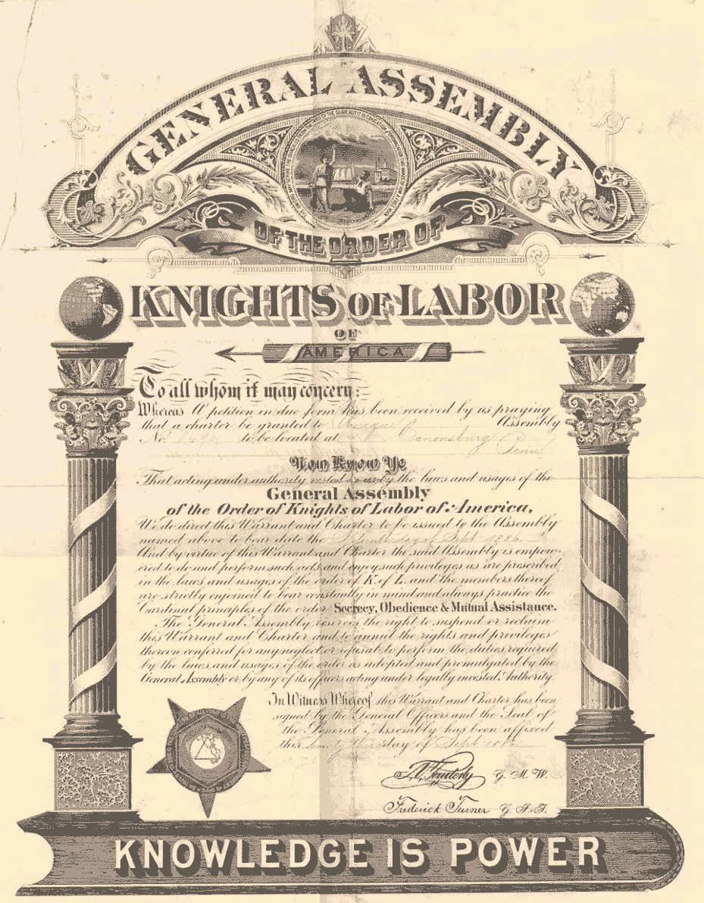
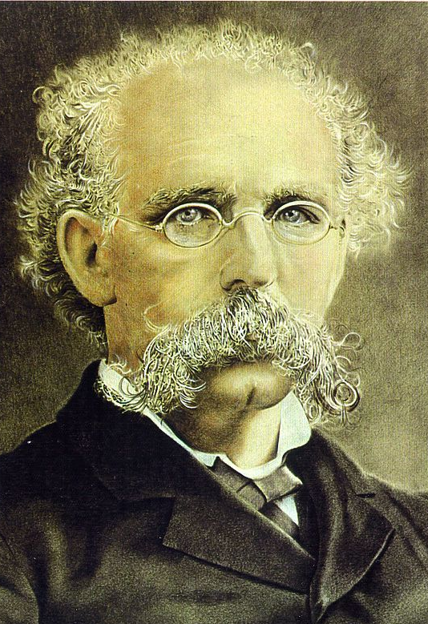
Knights of Labor
Terence V. Powderly
An injury to one is the concern of all!

Slide 47
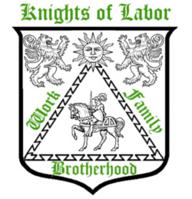
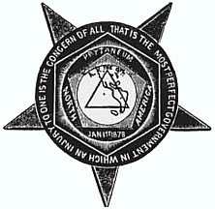
Goals of the Knights of Labor
Eight-hour workday.
Workers’ cooperatives.
Worker-owned factories.
Abolition of child and prison labor.
Increased circulation of greenbacks.
Equal pay for men and women.
Safety codes in the workplace.
Prohibition of contract foreign labor.
Abolition of the National Bank.

Slide 48
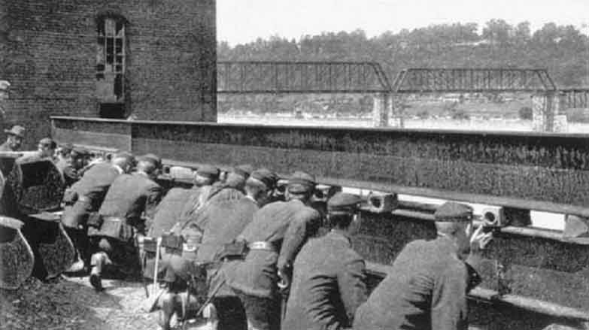
Strikes and Conflicts
Great Railroad Strike (1877)
Effective, but violent –
Businesses kept labor down
Homestead steel mills (1892)
lockout and Pinkertons
Pullman Boycott (1894)
Pullman Palace Car company
Nationwide boycott
President called in troops
Significance: These strikes show problems of class / money conflict in the US
Weakened unions temporarily

Slide 49
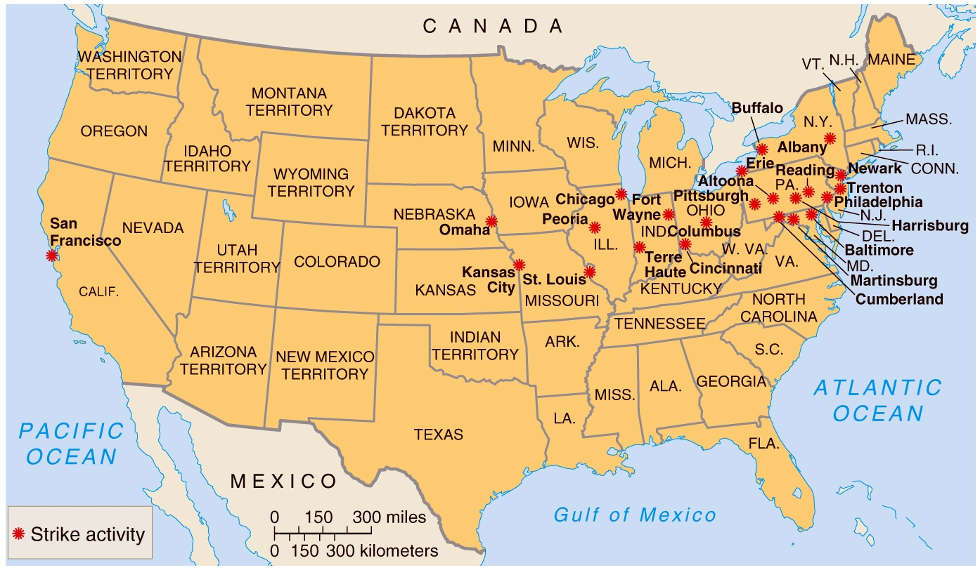
The Great Railroad Strike of 1877

Slide 50
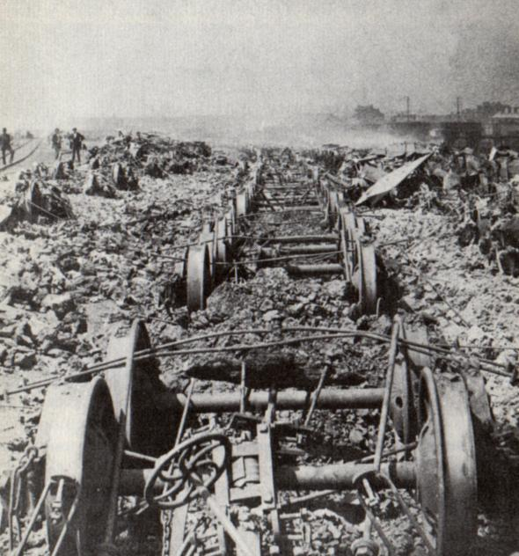
THE GREAT RAILROAD STRIKE OF 1877
CAUSES
The great Railroad Strike of 1877 began on July 16, when railroad workers for the Baltimore and Ohio Railroad staged a spontaneous strike after yet another wage cut. After President Rutherford Hayes sent federal troops to West Virginia to save the nation from “insurrection,” the strike spread across the nation.
RESULTS A picture of burned railroad cars during the mass strike.

Slide 51
1877 Railroad Strike

Slide 52
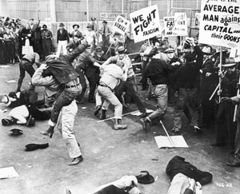
Business Strikes back
Scabs

Slide 53
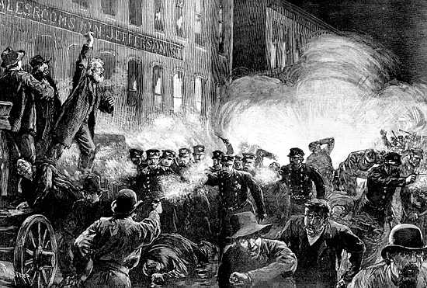
Haymarket Riot McCormack Harvesting Machine Company May 4, 1886

Slide 54
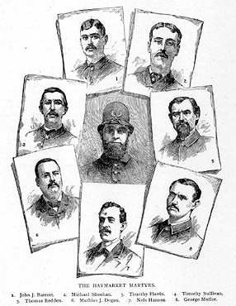
Haymarket Martyrs

Slide 55
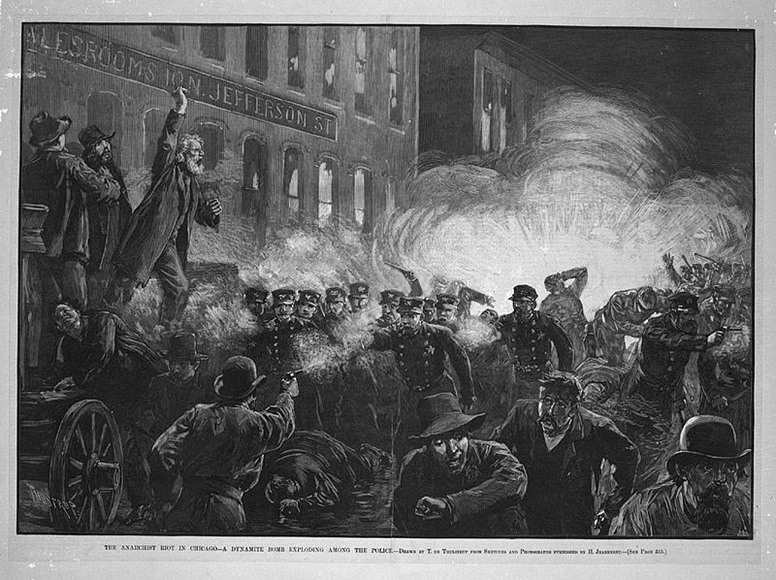
Haymarket Riot
1886

Slide 56
Haymarket Riot-
Causes: Haymarket Square prior to the demonstration as protestors being to rally because of the poor treatment they received..
Results: Police respond to the protestors and a bomb goes off… The result-. In response the police spray the crowd with bullets and 10 more workers die with another 50 injured.

Slide 57
Samuel Gompers founder of the American Federation of Labor
What does the American worker want?
MORE!

Slide 58
The American Federation of Labor (AFL)
Causes
founded by Samuel Gompers
made up of skilled workers who had belonged to national trade unions and needed a group to fight for their rights as workers
Results
gained better working conditions
higher pay & shorter hours
favored the use of strikes
1900 AFL = leading union in the US

Slide 59
Homestead Steel Strike (1892)
Homestead Steel Works
The Amalgamated Association of Iron & Steel Workers

Slide 60
CAUSES: Homestead Steel Strike: Workers went on strike for higher wages. Management refused to negotiate and locked out the workers, however the workers broke in and took control of the mill. Management hired the Pinkerton Police, which is a private security force, to take control back. 300 Pinkertons arrived by barge and were greeted by the workers. For 12 hours a battle ensued. The end result was the Pinkertons surrendered.

Slide 61
RESULTS: Carnegie then requested help from the Pennsylvania National Guard to restore control over the strikers after the Pinkertons had failed. Carnegie replaced 1700 strikers with new workers called strike breakers (scabs).

Slide 62
A “Company Town”:
Pullman, Illinois

Slide 64
Pullman Cars
A Pullman porter

Slide 65
The Pullman Strike of 1894
Government by injunction!

Slide 66
Pullman Strike:
CAUSES: Owner George Pullman, who hoped to prevent labor discontent, was not willing to grant high wages. Pullman housed his workers in a company town. Instead of living in tenements like other industrial workers of the day, Pullman workers lived in attractive company-owned houses, with indoor plumbing, gas, and sewers.
However, workers for Pullman lived in a "company town" where everything was owned by the corporation, including their housing and local store. The Pullman Company controlled every aspect of their lives, and practiced "debt slavery" Money owed was automatically deducted from workers' paychecks and frequently workers would never see their earnings at all. The workers children were responsible for the debt if the parents didn’t pay it off.
National Guard fires on Pullman strikers, from Harper's Weekly (1894)

Slide 67
Pullman Strike continued:
RESULTS
During the major economic downturn of the early 1890s, George Pullman cut wages without reducing the workers’ rent and other expenses. Discontented workers decided to stage a strike.
The strike effectively shut down production in the Pullman factories and led to a lockout.
The strike was eventually broken up by 12,000 U.S Army troops
President Grover Cleveland ordered the troops be sent in on the basis that the strike interfered with the delivery of U.S. Mail.
Federal Judge in Chicago issued an injunction against the strikers ordering them to stop striking.
By the end of the strike 13 strikers were killed and 57 were wounded. An estimated $80 million worth of property was damaged

Slide 68
Sweat shop 1905

Slide 69
http://www.history.com/topics/triangle-shirtwaist-fire

Slide 70
Anti Child Labor rally in New York City, early 1900s

Slide 71
Textile strike Lawrence Massachusetts 1911-12

Slide 72
A Striker Confronts a SCAB!

Slide 73
ILGWU:
International Ladies Garment Workers Union

Slide 74
Headline announcing Seattle General Strike, February 6, 1919

Slide 76
Eugene V. Debs
Founder of the American Railway Union
5 time Socialist Party candidate for President of the United States
imprisoned during World War I for speaking out against the war

Slide 77
Mother Jones 1830-1930 “The Miner’s Angel”
Mary Harris Jones.
Organizer for the United Mine Workers.
Founded the Social Democratic Party in 1898.
One of the founding members of the I. W. W. in 1905.

Slide 78
Industrial Workers of the World (“Wobblies”)

Slide 79
I W W

Slide 80
Big Bill Haywood, founder of the Wobblies
Violence was justified to overthrow capitalism.

Slide 81
IWW explanation of Capitalist society

Slide 82
Everett Herald November 6, 1916

Slide 84
The Rise & Decline of Organized Labor

Slide 87
Unions Today
1945 33% of workers
2008 12.4%
Not as powerful. Why?
Bad publicity
Foreign competition- cheaper workers overseas
Already good benefits- no further union need
Aggressive anti-union tactics

Slide 88
December, 2008

Slide 89
Unions today

Slide 91
Work Time, priorities
Write response, turnitin.com: How did the rise of industry affect the U. S. and its workers?
Make sure you’re familiar with Fishbowl topics
TCI chapters 13-14 challenge

