Slide 1
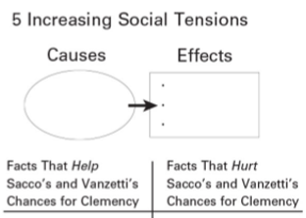
Groups (chapter 26)
ACLU: section 5
Nativists: section 5
IWW: section 3
Plymouth Cordage Company: section 3
East Boston Anarchists: section 4
Palmer Raids Official: section 4
Lowell Committee: sections 6 and 2

