Slide 1
Welcome!
It’s history time!

Slide 2
Goals for today
Note card, about you
Me quick intro
Student History Survey
Website familiarity
Evacuation map
Classroom info

Slide 3
Note card
Blank side: First name large and clear
Lined side: a few things about you that help me remember you

Slide 4
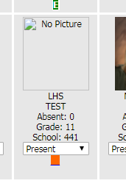

Slide 5
Me quick intro
Grew up
College
Hawaii, North Carolina, NYC
Maywood, Skyline, here

Slide 6
Student history survey
No correct answers, but think about how you would explain your ratings
#18: give details

Slide 7
Practice rebuttals
You said …
Actually … because

Slide 8
website
Check daily
Use the links
Let me know of questions

Slide 9
Evacuation map
Meet with period you are in
Previous period if during passing
3rd or 7th if during lunch

Slide 10
Classroom info
Rules and stuff:
Be reasonable.
Let me know how to be reasonable.

Slide 11
Have a great day!

