Slide 1
Event Focus: Apply your knowledge to make a new display!
--restate the event’s name
--list 4+ important knowledge-level facts (who, what, when, where)
--answer with 1-2 sentences why it was important
--name 2+ U. S. ideals that relate to the event, and explain how well the event shows us meeting those ideals
--create an interesting, relevant image or design that helps us remember
If you finish, read chapter 3 on phone or computer.

Slide 2
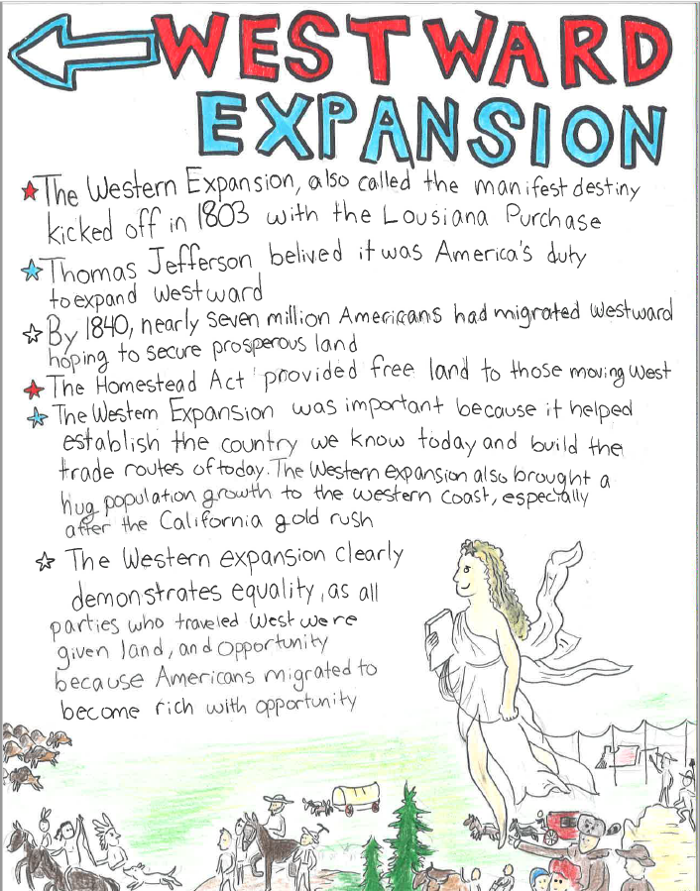
--restate the event’s name
--list 4+ important knowledge-level facts (who, what, when, where)
--answer with 1-2 sentences why it was important
--name 2+ U. S. ideals that relate to the event, and explain how well the event shows us meeting those ideals
--create an interesting, relevant image or design that helps us remember
If you finish, read chapter 3 on phone or computer.

Slide 3
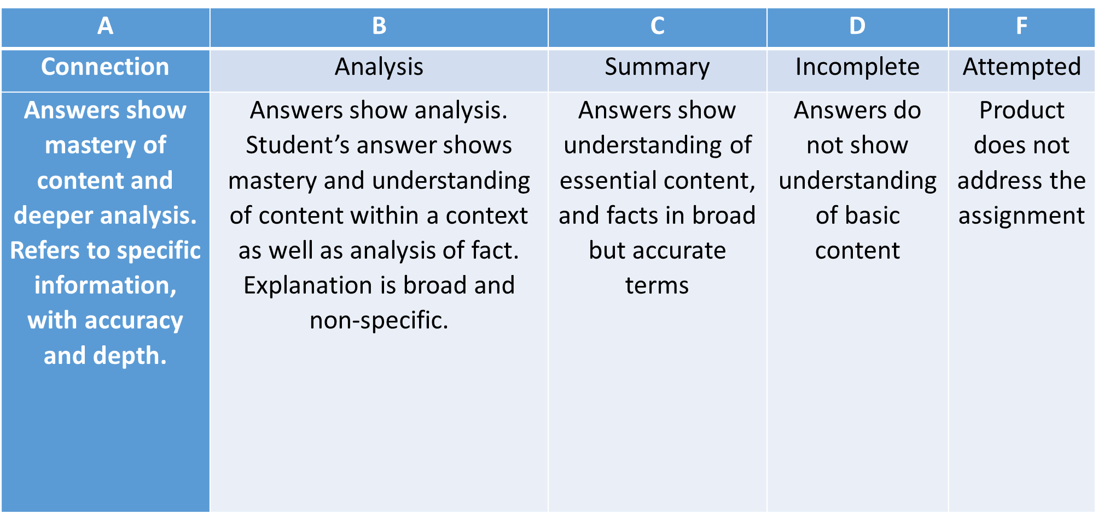
Event Display Rubric (20 points):
A=powerful and creative re-named title, helpful names and dates, detailed and specific “why important” and ideals connection, smashing design that connects with new title, ideals, and “why important”

Slide 4
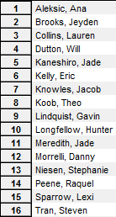
1673 map
Boston Massacre
Civil War
Westward Expansion
The Progressive Era
Building an Empire
WWI
The Twenties
Depression and New Deal
WWII
Early Cold War
’50s
Civil Rights Movement
’60s
The Vietnam War
’70s
Reagan Revolution
9/11

Slide 5
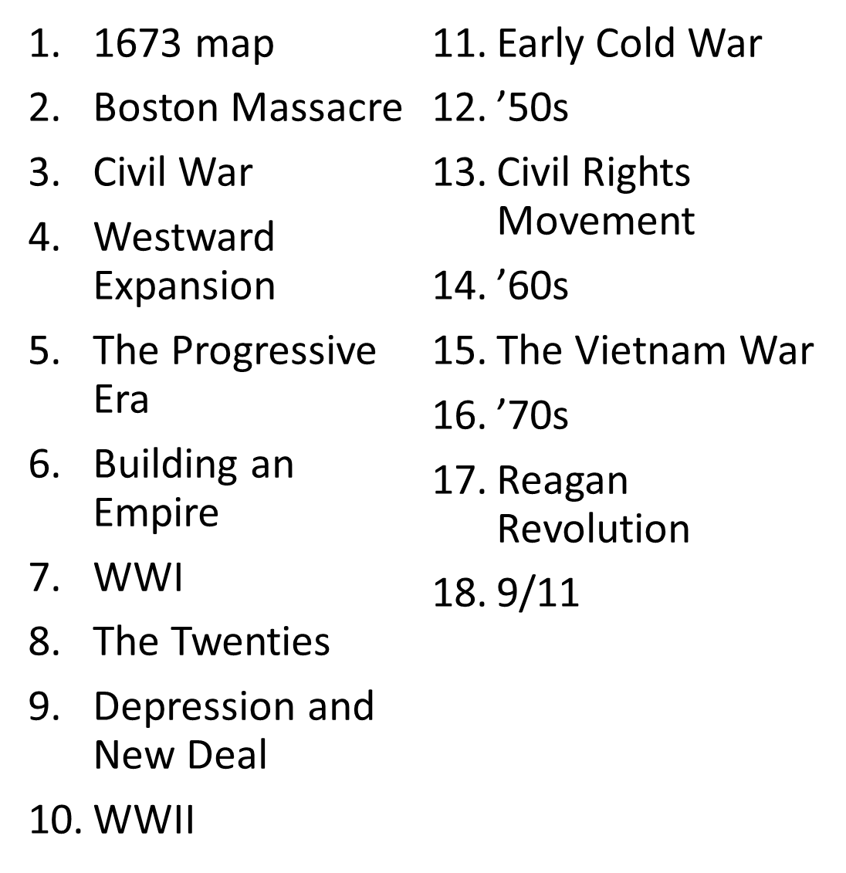
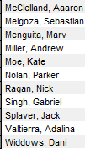
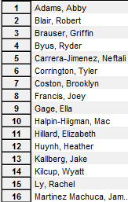

Slide 6
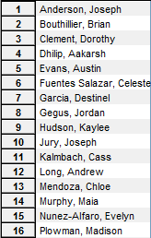
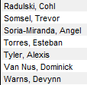

Slide 7
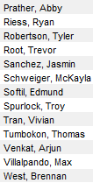
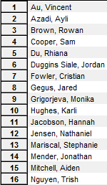

Slide 8
