Slide 1
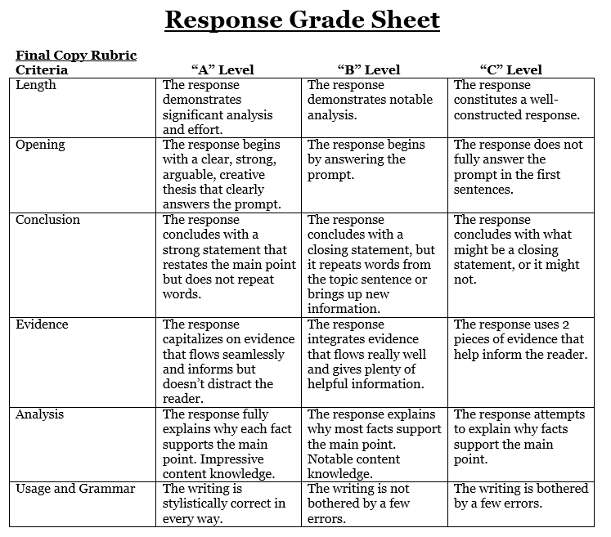
Electoral College debate paragraph: 8 glorious sentences
Claim (thesis for what specifically should be done and why that change would help in some specific, important way
Evidence (detail about the College or your plan)
Analysis (2+ sentences to analyze evidence and connect to thesis)
Evidence
Analysis
Conclusion

