Slide 1
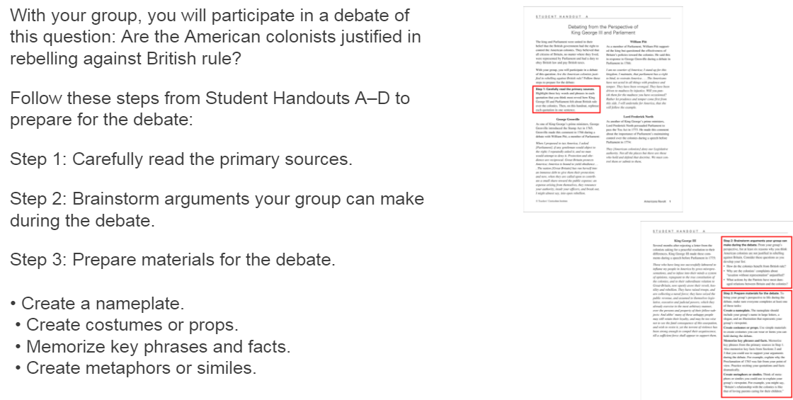

Slide 3
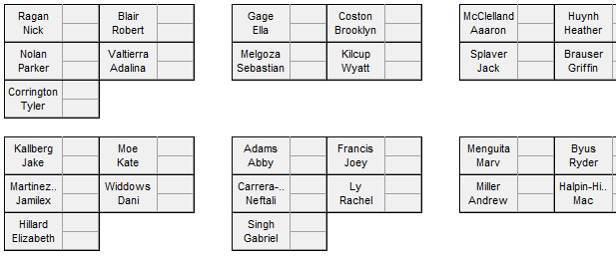

Slide 4
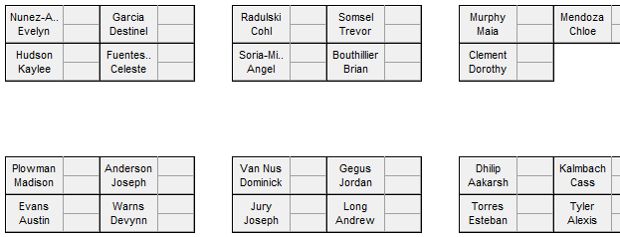

Slide 5
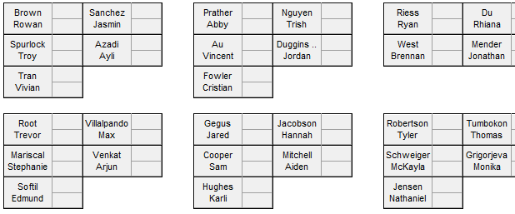

Slide 7
Prepare for debate! Critically read
Back of blank paper:
Group members’ names, what they will do to contribute
Step 2: list arguments for why (or why not) the rebellion is justified
Step 3:
list 5+ key facts and/or phrases
List 3+ metaphors or similes to use

Slide 8
How will you incorporate review into debate?
Essence of Dialogue and Debate
Mind Maps and Notetaking
American Ideals
American Geography
Details of Colonial Regions and History
Important Documents and Ideas
Events Leading to Revolution
Revolutionary War

