Slide 1
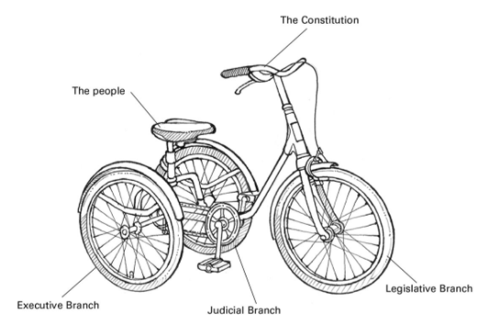
Constitution Metaphor Project

Slide 2
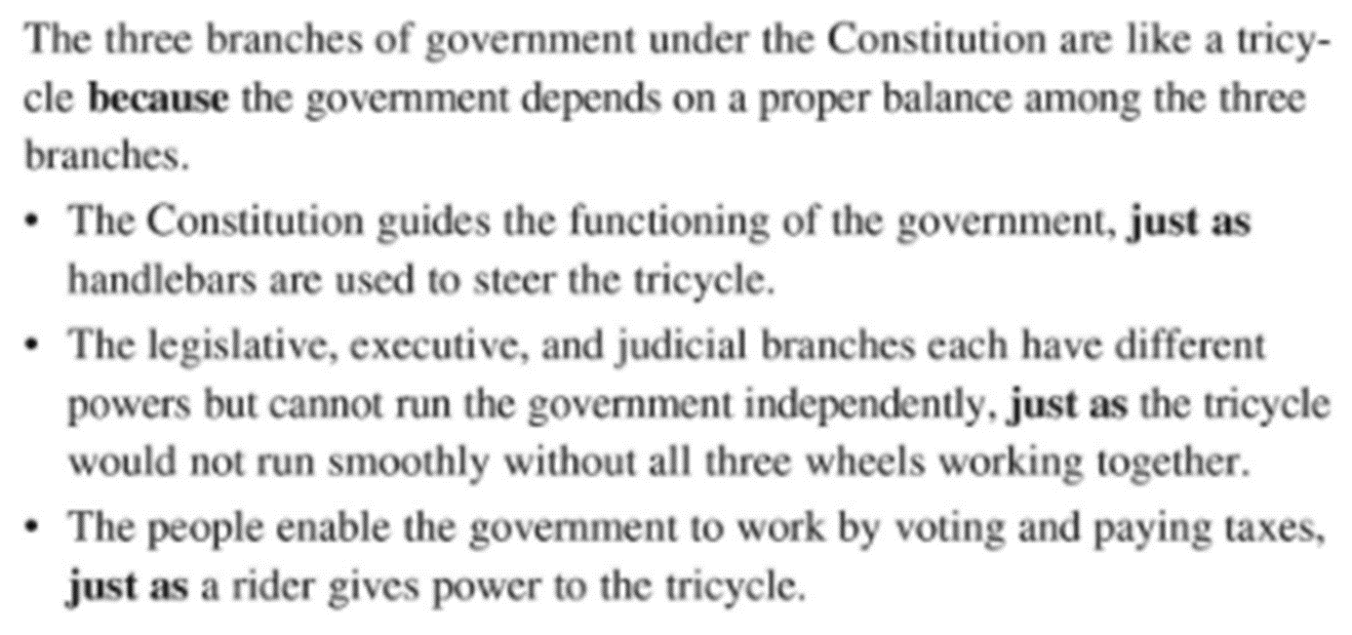

Slide 3
Directions: Solo or with a partner
Visually represent the federal government.
Use a different metaphor than branches! No trees. No circuses. No tricycles.
Explain your metaphor thoroughly–a few sentences for each branch.
Answer these questions with words and images:
What each branch does for the law (ex: “makes it”)
Who makes up each branch (people, jobs, groups) and their requirements
Real people! (William Barr is Attorney General for the Executive Branch)
The powers of each branch (example: Commands U. S. military)
Real examples. (President Trump signed ________ that _________.)
Checks on the other branches
Real examples. (Congress did not approve Trump’s ______>)
As many additional facts as possible, organized!!!

Slide 4
Grading
A:
Complete details that answer all questions (what does each branch do for the law, specifically, and how do they relate?)
Real examples and people and many checks and balances (12+ total)
Great source of clear info (colors, space)

Slide 5
Grading
B:
Good details that answer most questions
Many checks and balances
Great source of clear info (colors, space)

Slide 6
Grading
C:
Some good details
Some checks and balances
Good source of clear info (colors, space)

Slide 8
TCI book help
Checks and balances, 65
Legislative branch, 67
Executive branch, 69
Judicial branch, 71

