Slide 1
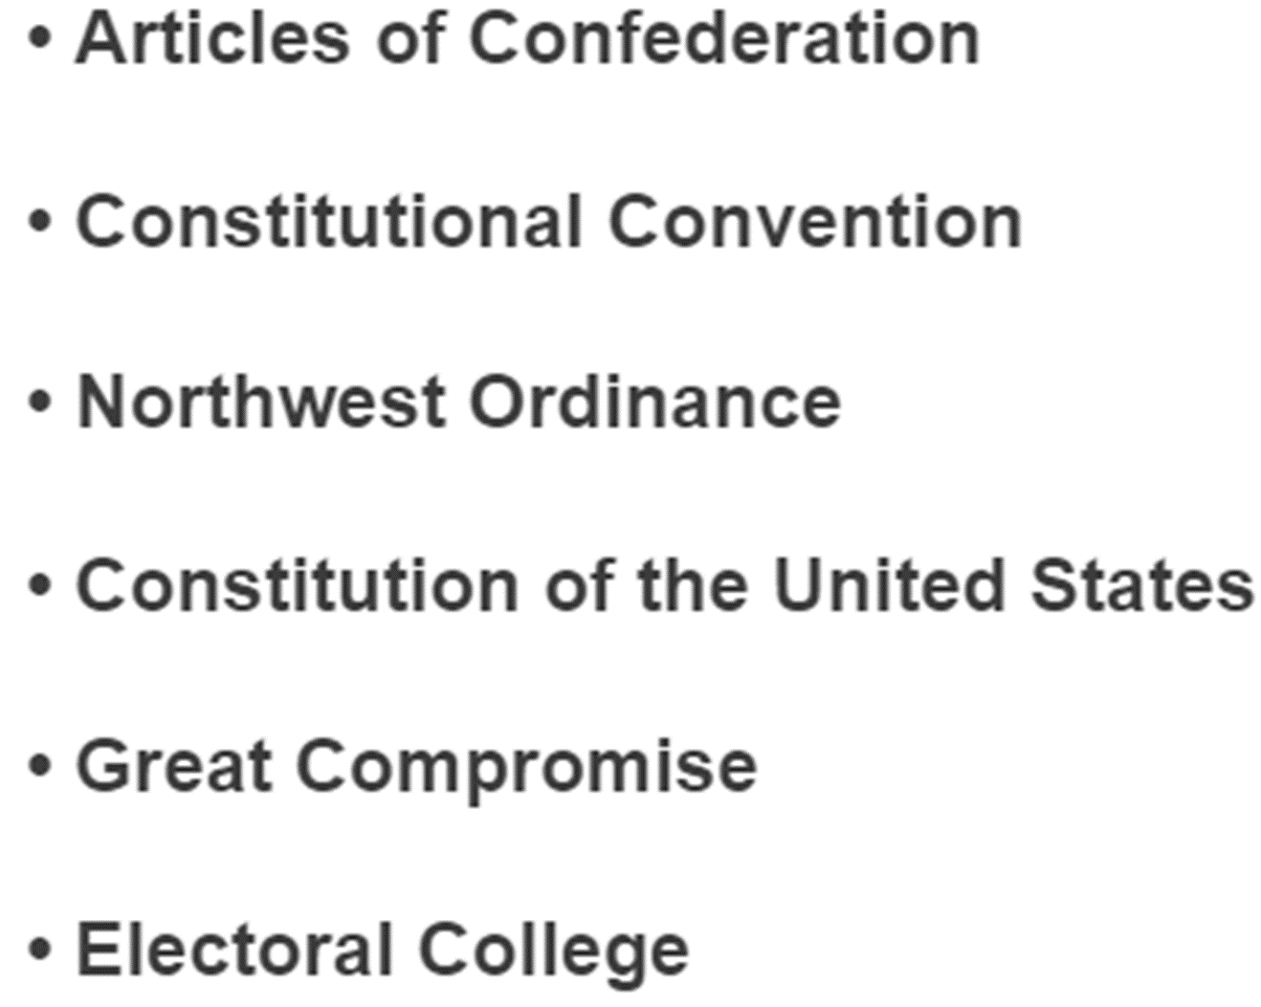
Unit 2, The Constitution
What do these mean?
Why are they important?
How do they compare?
Analyze the details?
Create your own (Constitution)or evaluate ours.

Slide 2
Chapter 6:

Slide 4
Analyzing the Features of the Articles of Confederation

Slide 5
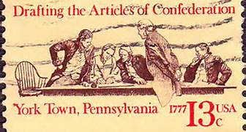
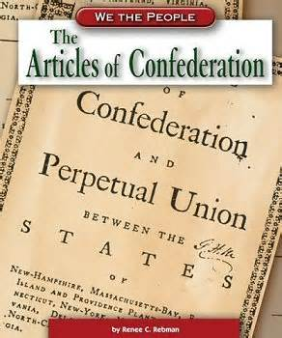
The Articles of Confederation 1777-1787
What strengths did the Articles have? (Why did the states approve it?)
What weaknesses did the Articles have?

Slide 6
A) No chief executive
Why was it included?
Wanted to make sure that the executive branch (King/President) did not have too much power.
Possible Problems
Lack of leadership from central government.
No single leader for the government

Slide 7
B) 9 of 13 to create laws
Why was it included?
States wanted to protect individual states’ power.
Fear of a strong central government.
Possible problems..
Difficult to get 9 states to agree on a law.
Central government was unable to do very much because it need so much approval.

Slide 8
C) Congress could not tax
Why was it included?
States were afraid of being unfairly taxed by the central government, as they had been under British Rule.
Possible problems…
States often chose not to pay taxes.
Federal government didn’t have the funds to operate effectively.

Slide 9
D) Congress could not draft an army
Why was it included?
Fear of central government with a strong army that might take away citizens’ rights.
Possible problems..
Left country vulnerable without a dependable military force.

Slide 10
E) No national court system
Why was it included?
Fear of a central government with a court system that might be unfair to the rights of states.
Possible problems…
Disputes between states often could not be settled fairly.

Slide 11
F) Amendments need all 13 states approval
Why was it included?
Wanted to make sure states had a strong say in the shaping of the government
Possible Problems…
Nearly impossible to make changes to the Articles. Any one state could stop an amendment that all the other states wanted.

Slide 12
G) Could not collect debts of states
Why was it included?
Fear of a strong central government that could force states to pay for things they didn’t want.
Possible problems…
Federal government often didn’t have the funds necessary to operate effectively.

Slide 13
H) Congress could not settle disputes
Why was it included?
Wanted states to have the ultimate authority in resolving disputes.
Possible Problems…
Disputes among states often could not be resolved.
Created disunity among states.
NOTE – Congress could settle disputes only on appeal or as a last resort

Slide 15
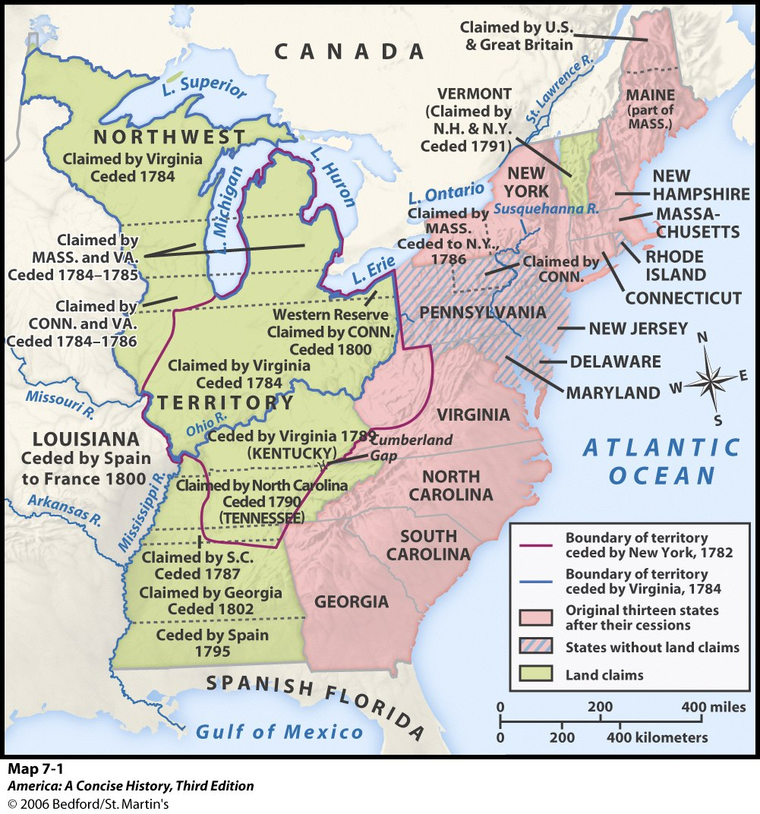

Slide 16
Painting of Shay’s Rebellion
Problems in the Confederation
Foreign relations were bad
Trade Markets were closed
There were many internal problems
Shays’ Rebellion
This all caused a push for a change

Slide 18
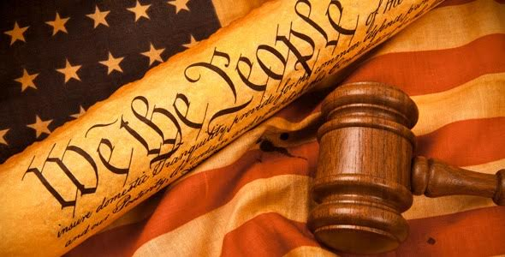
The Making of the American Constitution

Slide 19
Constitutional Convention of 1787
Hot!!! Hot!!! Hot!!!
May – September
Met in same room as which Declaration was signed.
Was supposed to start May 14th, but only delegates from Virginia and Pennsylvania were there.
Drafted the Virginia Plan and the New Jersey Plan

Slide 20
A Snapshot
55 delegates from 12 Colonies
No Rhode Island
Major players not present
John Adams, Thomas Jefferson, Thomas Paine, Patrick Henry or Sam Adams
The Delegates…
1/3 of them owned slaves
Relatively young (mid 40s)
The were the “well bred, the well fed, the well read, the well wed.”
They were able to agree, right away on…
Creating a Constitutional Government
Government that would protect the rights of the people
It would be republican in nature
Would have a separation of powers (Legislative, Judicial & Executive)
Power would be divided between states and federal government
This meant the AOC was out and some bigger questions arose.

Slide 21
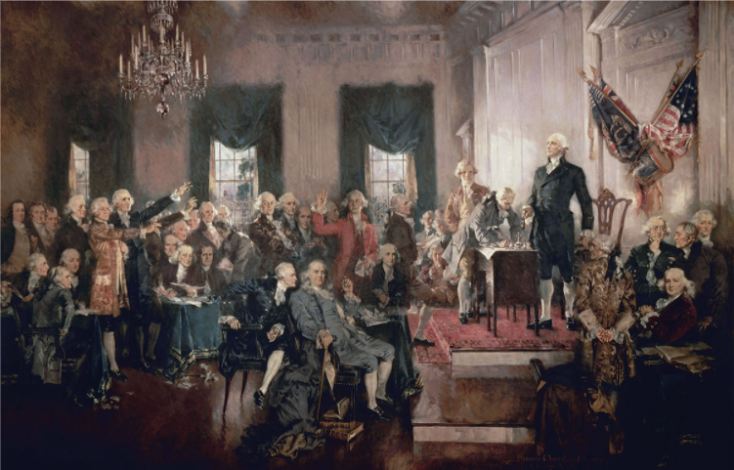

Slide 22
Compromises
What were the sides? What did they want? How did they compromise?
Great Compromise (Crash Course)
Representation (bicameral legislature)
3/5 Compromise
Counting slaves as population?
Executive(s)?
How to prevent tyranny?

