Slide 1
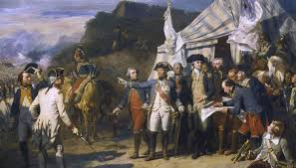
Chapter 4, The Colonial Period

Slide 2
Magna Carta 1215
What: new rules that limited—for the first time—the power of the King of England
Why important: the first step toward limiting monarchal powers

Slide 3
Mayflower Compact 1620
What: It was the first governing document of Plymouth Colony. It was written by the male passengers of the Mayflower, consisting of separatist Puritans, adventurers, and tradesmen. The Puritans were fleeing from religious persecution by King James of England.
Why important: It started the democratic process in America (even though it excluded women)

Slide 4
Act of Religious Toleration 1649
What: Maryland law mandating tolerance for less-popular types of Christianity
Why important: set a precedent for (a bit) of religious freedom

Slide 5
English Bill of Rights 1689
What: declared rights and liberties of English people
Why important: continued to limit the power of the king

Slide 6
House of Burgesses 1619-1776
What: each county sent two representatives (burgesses) to make laws for the colony of Virginia
Why important: establish representative democracy in the American colonies

Slide 7
Great Awakening 1730s
What: greater emphasis on Protestant Christianity in the colonies (and Britain) as a personal thing—not dictated by the king
Why important: gave colonists the confidence that god was on their side and would be important for people in America

Slide 8
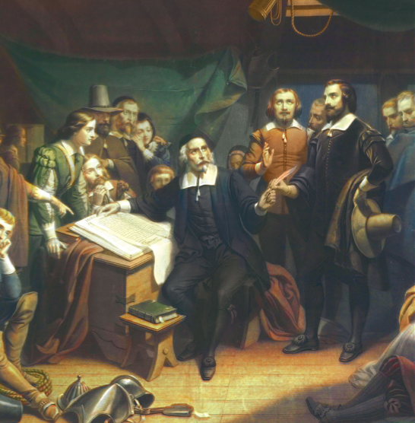

Slide 9
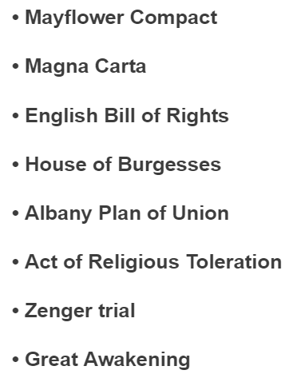
The Zenger Trial Crash Course Free Press Albany Plan of Union
Who
What
When
Where
Why important?

Slide 10
Colonial Regions
Environment, Culture, and Migration.

Slide 11
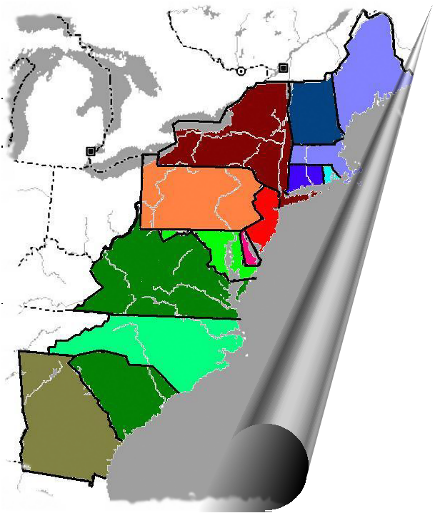
The Three Regions
New England
Middle Colonies
Southern Colonies

Slide 12
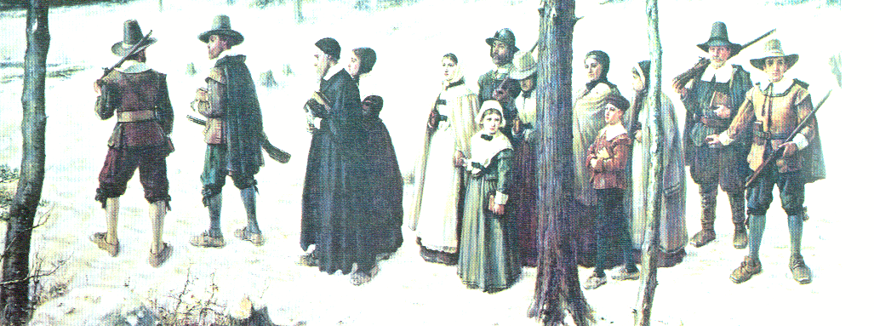
New England Environment
Northern Eastern Woodlands
Very Short Growing Season
Long Cold Winters
Large Forests
On the Atlantic Ocean

Slide 13
New England Culture
PRODUCTS
Subsistence Farming
Timber and Ship Building Supplies (Rope, Masts, Tar)
Dried Fish
Rum and other Manufactured Trade Goods
PEOPLE
Puritans and Pilgrims who believed in working hard and following strict rules.
Merchants, Manufacturers, and Lawyers.

Slide 14
New England Government
Self-Governing Charters
Town Meetings
The Mayflower Compact
The Fundamental Orders of Connecticut
New Hampshire
Massachusetts
Connecticut
Rhode Island

Slide 15
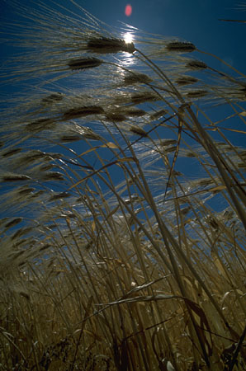
Middle Colonies Environment
Lower Eastern Woodlands
Medium growing season and cold winters.
Many lakes and rivers for transportation.

Slide 16
Middle Colonies Culture
PRODUCTS
Called the Bread Colonies
Farmed Wheat, Oat, Barley and Rye.
Made homespun products.
Self-sufficiency!
Traded very little, at first, but then the most later.
PEOPLE
People from: England, the Netherlands, France, Germany and others.
Puritans, Quakers, Anglicans, Catholics, and Jews.

Slide 17
Middle Colonies Government
New York
Proprietary Charters
Religious Freedom and Tolerance
Freedom of the Press—Zenger
Strong Courts
Pennsylvania
New Jersey
Delaware

Slide 18
Southern Colonies Environment & Culture
ENVIRONMENT
Atlantic and Gulf Coastal Plains.
Long growing season and fertile land.
Warm for most of the year
PRODUCTS
Farmed Tobacco, Rice, Indigo, and Cotton.
Trade “cash crops” farmed on Plantations.
Purchase manufactured goods.

Slide 19
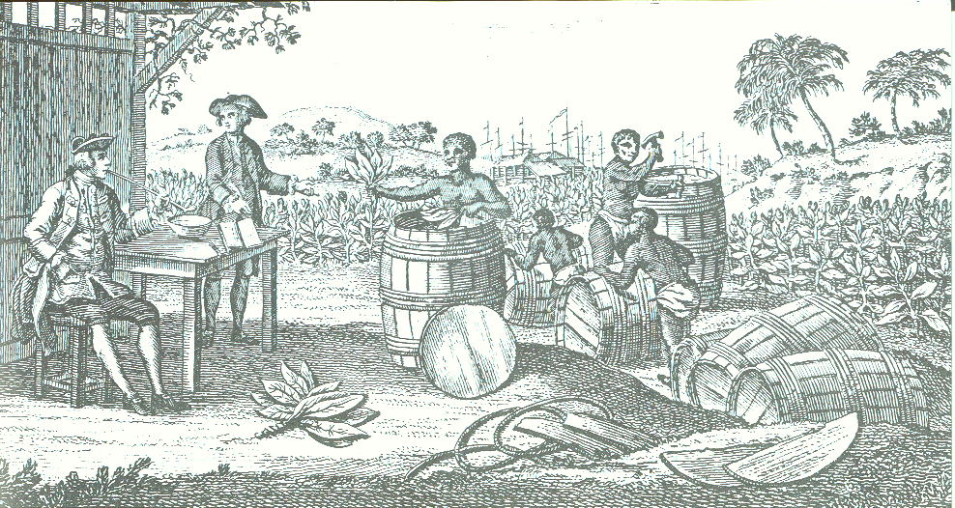
Southern Colonies Culture
Anglicans
English Plantation Owners, Indentured Servants, Transported Criminals, and Slaves.

Slide 20
Southern Colonies Government
Maryland
Virginia
Joint-Stock and Proprietary Charters.
The House of Burgesses
Colonies run for the profit of the Joint-Stock Company or Proprietors.
North Carolina
South Carolina
Georgia

Slide 21
Colonial Regions Vocabulary
Merchant: A person who produces or trades goods.
Subsistence Farming: When a family grows only enough food to survive.
Homespun: Products that are made at home (furniture, clothing, etc.)
Cash Crops: Crops that are grown in large amounts and sold for a profit.

Slide 22
Colonial Regions Vocabulary
Indentured Servants: People who are brought to the colonies and must work to pay off the trip.
Transported Criminals: Criminals that are taken from jail and made to work in the colonies.
Slaves: People captured in Africa and sold to plantation owners. The plantation owner saw them as property.

Slide 23
The Zenger Trial Crash Course Free Press Albany Plan of Union
Who
What
When
Where
Why important?

Slide 24
Colonial America Questions Share
Write your best questions on the white sheets, landscape. 1 QUESTION PER PAPER
Name on top-left
Leave your question, travel to new table
Answer a question, below it (name after question)
Name the level of thinking for the question by your answer
Go back to your table, check out the answers
Clarify any differences with me or the question-answerer

Slide 25
Compare and Contrast: Colonial Regions
Words that will make us less sad when we know exactly how to respond quickly, efficiently, and brilliantly!

Slide 26
The Question
“Compare and contrast ________ and __________.”
Or
“Give similarities and differences between ________ and ________.”
Real Meaning:
What is one way to summarize the relationship between these two things?
Then give at least one example of a similarity and a difference to support your opinion of the relationship.

Slide 27
Examples of Thesis Statements
Superior toughness defines the relationship between the Super Bowl champion Seahawks and the defeated Broncos.
While Godzilla attracted moviegoers, X-Men’s ability to inspire makes it more resonant.
Science class relates more than any other class to real skills that can make the world better, especially math.

Slide 28
What is the best colonial region? (AKA compare and contrast two regions)
5-6 sentence paragraph
Thesis (claim): Compared with __________ region, ________ region’s __________ allowed for ____________, resulting in ______________.
Evidence (1-2 sentences, for both regions):
Analysis (usually two sentences, to connect evidence to thesis):
Conclusion:

