Slide 1
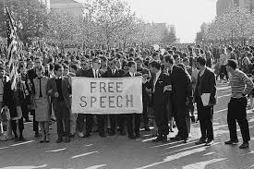
Have we honored the rights in the Bill of Rights well? Are we honoring them today, moving toward our ideals?

Slide 2
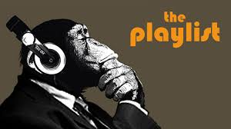
Do you choose which songs to listen to?

Slide 3
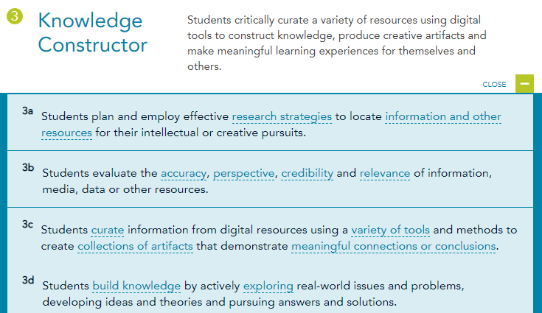

Slide 5
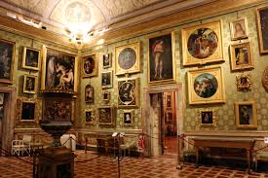
Your Job: Bill of Rights Museum Curator

Slide 6
Bill of Rights: One Right’s Interpretation Today
You are the curator of a Bill of Rights Museum
Choose one right
Research the way it’s interpreted today
Find the three best sources with images—the ones that tell the whole story (as much as possible) about the right today
Paste links and images onto a PPt or similar
Write 2-3 sentences for each source to summarize what it says
Write a thesis for the way that right’s interpretation either moves the U. S. closer or further away from its ideals, based on your perfectly curated sources
Post to Seesaw
Review and comment on others’ project

Slide 7
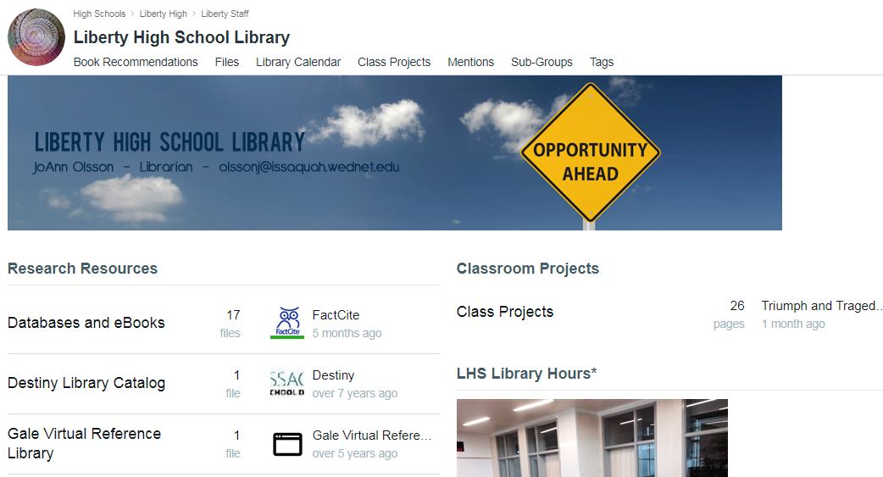

Slide 8
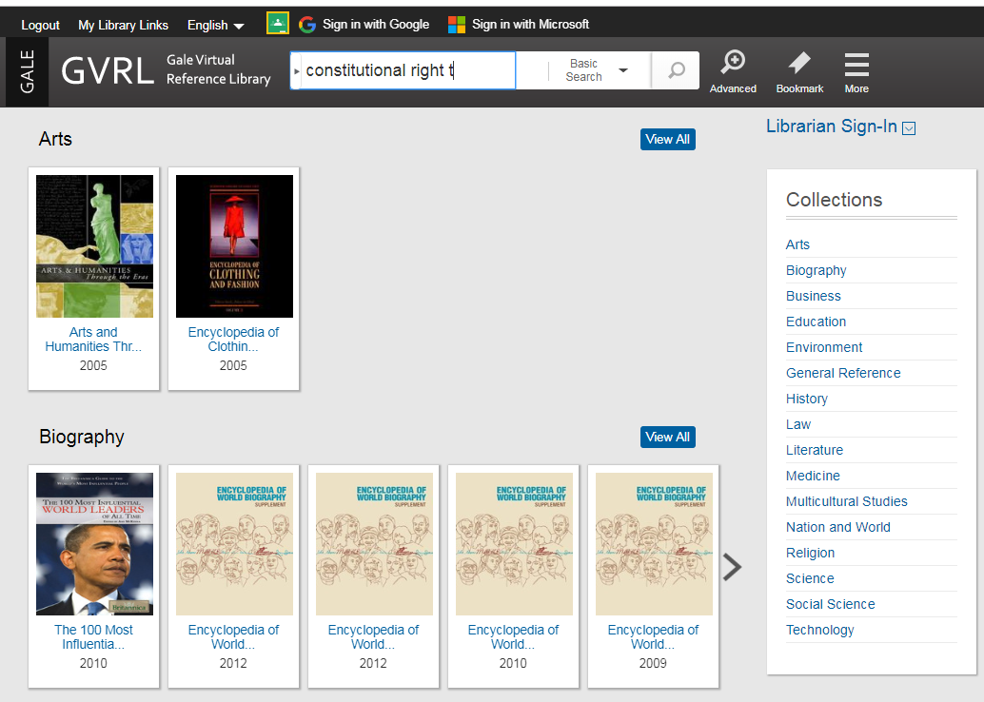

Slide 9
Finish, Day 18
Make sure SuperFlyer! is posted to Seesaw
Create your Bill of Rights Museum and post on Seesaw
Play the Bill of Rights games
Annotate the study guide

