Slide 1
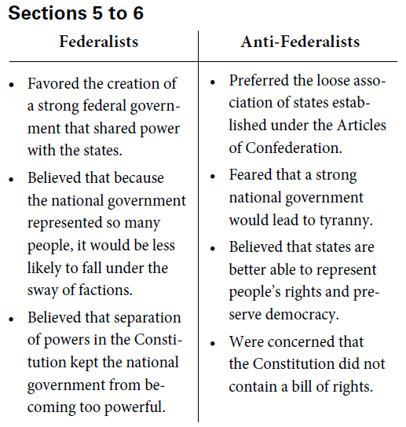

Slide 2
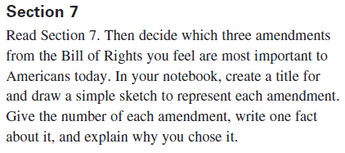
Bill of Rights

Slide 3
Amendment One
The right to freedom of speech, press, religion, petition, and peaceful assembly
Congress shall make no law respecting an establishment of religion, or prohibiting the free exercise thereof; or abridging the freedom of speech, or of the press; or the right of the people peaceably to assemble, and to petition the government for a redress of grievances.

Slide 4
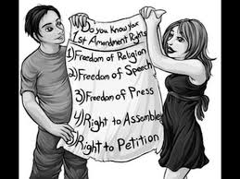

Slide 6
Prior Restraint

Slide 7
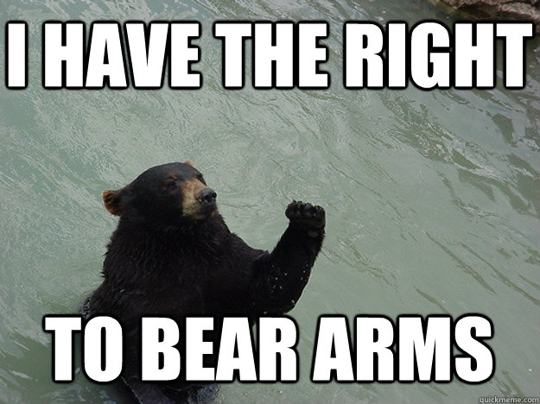
Amendment Two
Right of a state militia to bear arms
A well regulated militia, being necessary to the security of a free state, the right of the people to keep and bear arms, shall not be infringed.

Slide 8
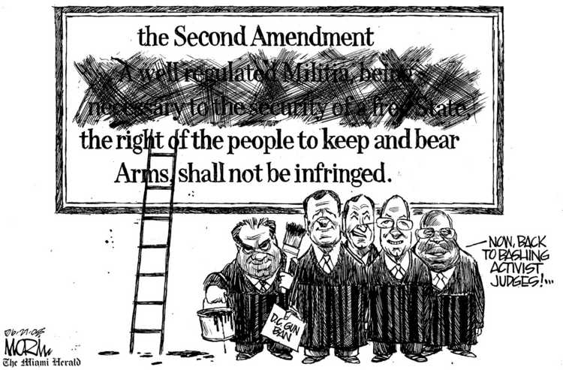
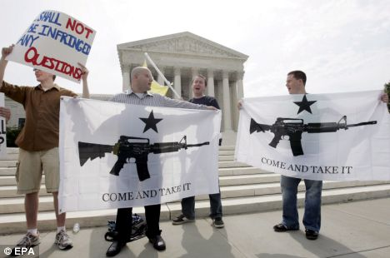
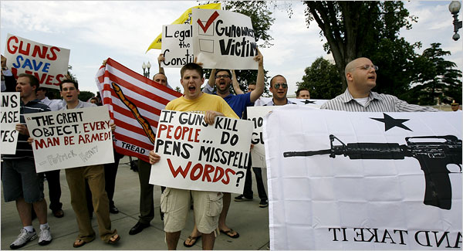
Individual Gun Rights?
District of Columbia
versus Heller

Slide 9
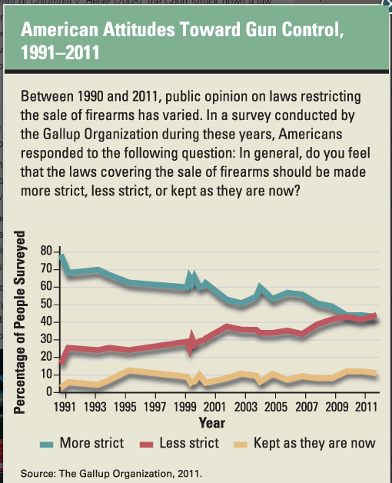
Why?

Slide 10
Amendment Three
No forced housing of soldiers
No soldier shall, in time of peace be quartered in any house, without the consent of the owner, nor in time of war, but in a manner to be prescribed by law.

Slide 11
Amendment Four
Right to privacy
The right of the people to be secure in their persons, houses, papers, and effects, against unreasonable searches and seizures, shall not be violated, and no warrants shall issue, but upon probable cause, supported by oath or affirmation, and particularly describing the place to be searched, and the persons or things to be seized.

Slide 12
Amendment Five
No double jeopardy; protection against self-incrimination
No person shall be held to answer for a capital, or otherwise infamous crime, unless on a presentment or indictment of a grand jury, except in cases arising in the land or naval forces, or in the militia, when in actual service in time of war or public danger; nor shall any person be subject for the same offense to be twice put in jeopardy of life or limb; nor shall be compelled in any criminal case to be a witness against himself, nor be deprived of life, liberty, or property, without due process of law; nor shall private property be taken for public use, without just compensation.

Slide 13
Amendment Six
Right to a lawyer and a speedy trial
In all criminal prosecutions, the accused shall enjoy the right to a speedy and public trial, by an impartial jury of the state and district wherein the crime shall have been committed, which district shall have been previously ascertained by law, and to be informed of the nature and cause of the accusation; to be confronted with the witnesses against him; to have compulsory process for obtaining witnesses in his favor, and to have the assistance of counsel for his defense.

Slide 14
Amendment Seven
Right to a jury trial
In suits at common law, where the value in controversy shall exceed twenty dollars, the right of trial by jury shall be preserved, and no fact tried by a jury, shall be otherwise reexamined in any court of the United States, than according to the rules of the common law.

Slide 15
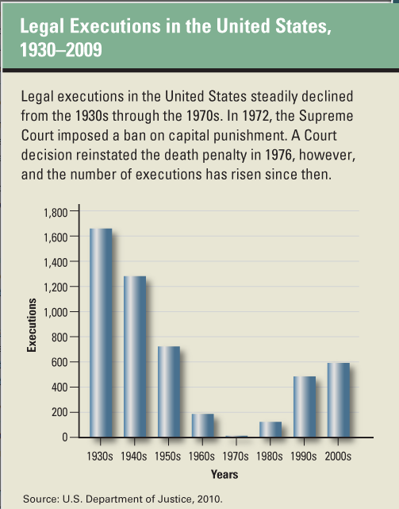
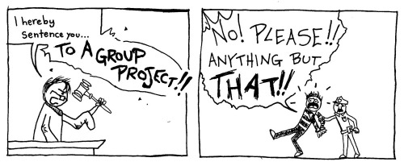
Amendment Eight
Protection from cruel and unusual punishment
Excessive bail shall not be required, nor excessive fines imposed, nor cruel and unusual punishments inflicted.

Slide 16
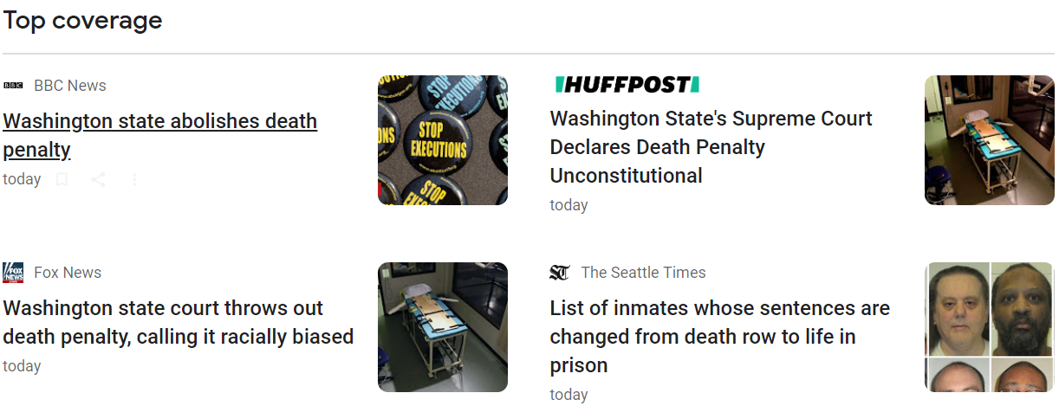

Slide 17
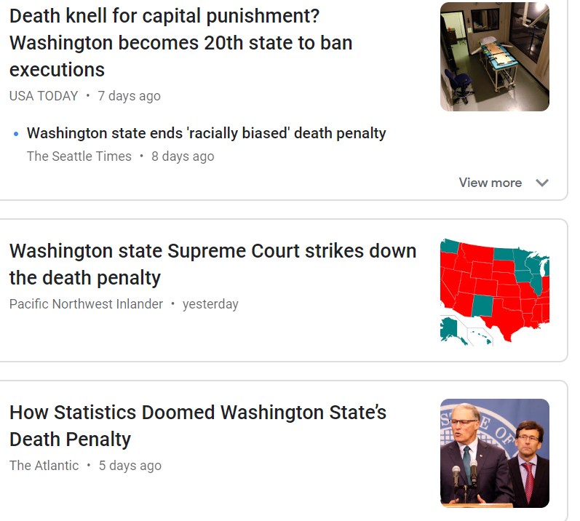
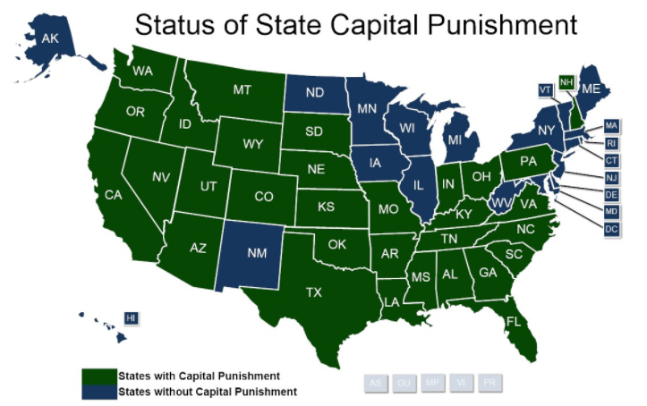

Slide 18
Amendment Nine
Not every right kept by the people is stated in this document
The enumeration in the Constitution, of certain rights, shall not be construed to deny or disparage others retained by the people.

Slide 19
Amendment Ten
All powers not given to the federal government are given to the states and the people
The powers not delegated to the United States by the Constitution, nor prohibited by it to the states, are reserved to the states respectively, or to the people.

Slide 20
Bill of Rights Review Games and Cool Sites
Annenberg
Icivics
Annenberg That’s Your Right
Constitution Center
Teaching Civics
Bill of Rights Instititute

