Slide 1
Anti-Suffrage
Here’s what some people had to say about the idea of women voting…

Slide 2
Preview
With your table group discuss the OPVL of the documents you have.
What arguments are they making?
What logic are they using?
How could someone refute that logic?
  Could you create similar arguments deny other groups of people privileges or rights?

Slide 3
A little Background
Throughout history, there were people who did not want women to vote. Women would work, they would pay taxes, they would technically be considered citizens... but voting was for men. In America, when the right to vote was extended to include all races, all social positions, and all incomes, women were still not included. It didn't matter if a man was illiterate, had been to jail, or if he was the town drunk. He could vote, and a woman, no matter who she was, could not.
Women suffragists (suffragettes) began campaigning in democratic countries all over the world to change this, starting in the mid-19th century. Their campaigns were largely peaceful and dignified... at least by 21st century standards. But by 19th century standards, these women were abhorrent and indecent, making fools of themselves by demanding to be treated like men.

Slide 4
One of the most notable things about the arguments put forth by the anti-suffragette movement was how weak its position was. Anti-suffragette arguments relied heavily on emotional manipulation and downright hateful nastiness. Humor was a much-used weapon against suffragettes. They were easy to depict as embittered old maids, brutal scolds, and cigar-smoking transvestites.
By Therese Oneill (The Week)

Slide 5
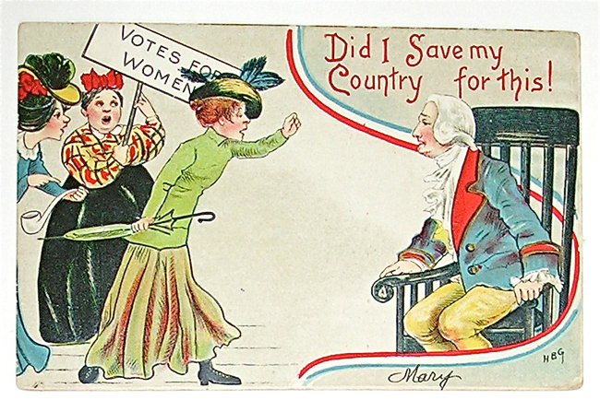
Message, Purpose, Value, limitations

Slide 6
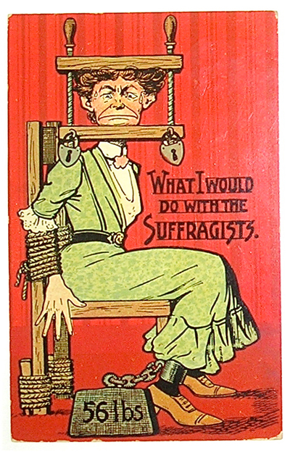
Message, Purpose, Value, limitations

Slide 7
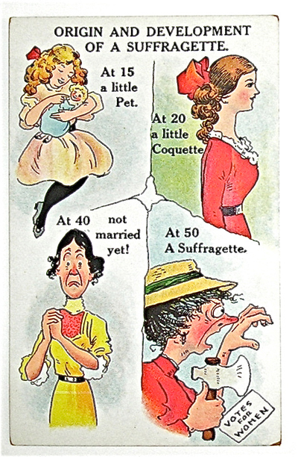
Message, Purpose, Value, limitations

Slide 8
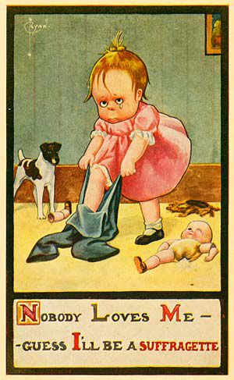
Message, Purpose, Value, limitations

Slide 9
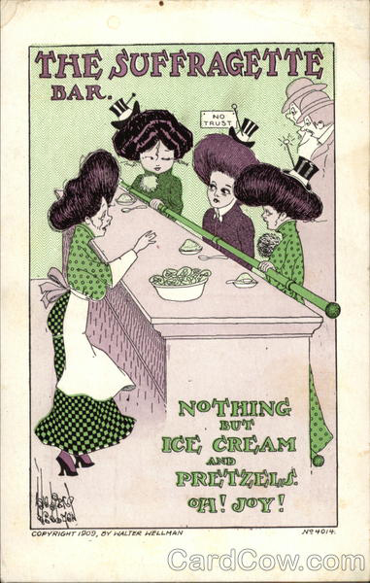
Message, Purpose, Value, limitations

Slide 10
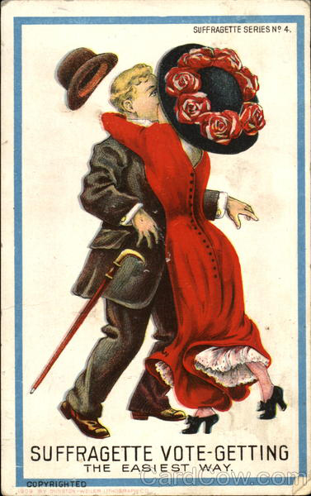
Message, Purpose, Value, limitations

Slide 11
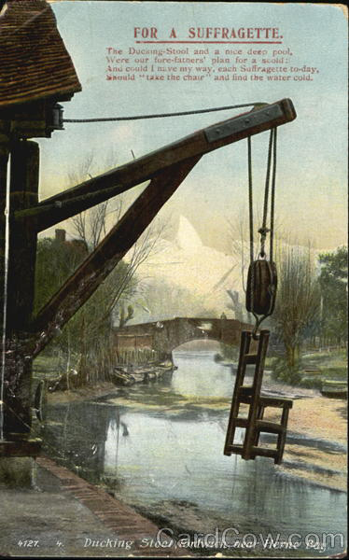
Message, Purpose, Value, limitations
The Ducking Stool
And a nice deep pool
Were our forefathers
Plan for a scold
And could I have my way
Each suffragette today
Should “take the chair”
And find the water cold

Slide 12
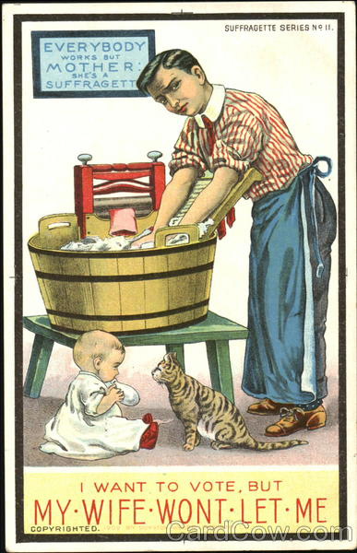
Message, Purpose, Value, limitations

Slide 13
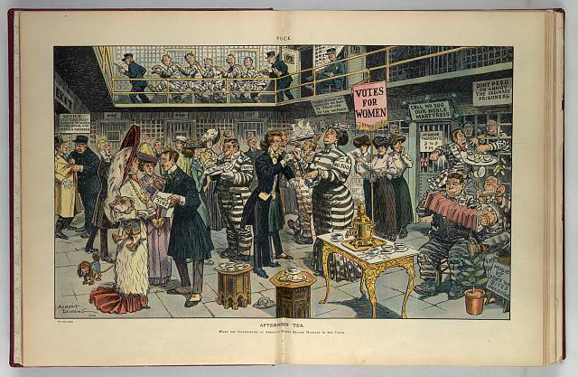
Message, Purpose, Value, limitations

Slide 14
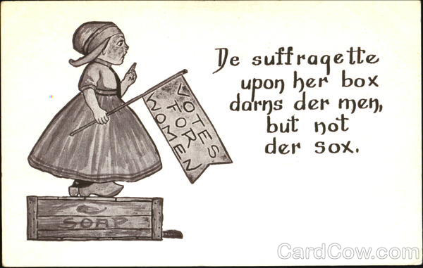
Message, Purpose, Value, limitations

Slide 15
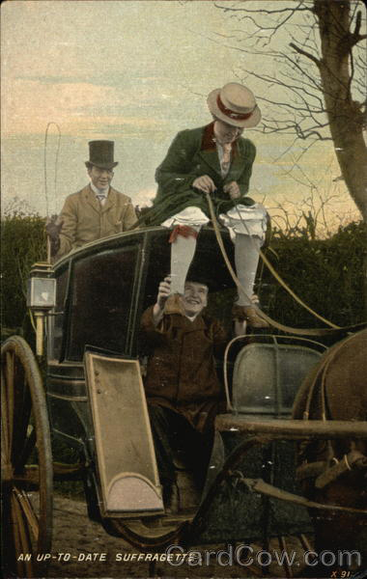
Message, Purpose, Value, limitations

Slide 16
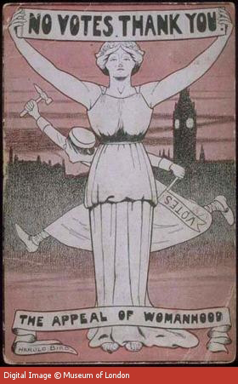
Message, Purpose, Value, limitations

Slide 17
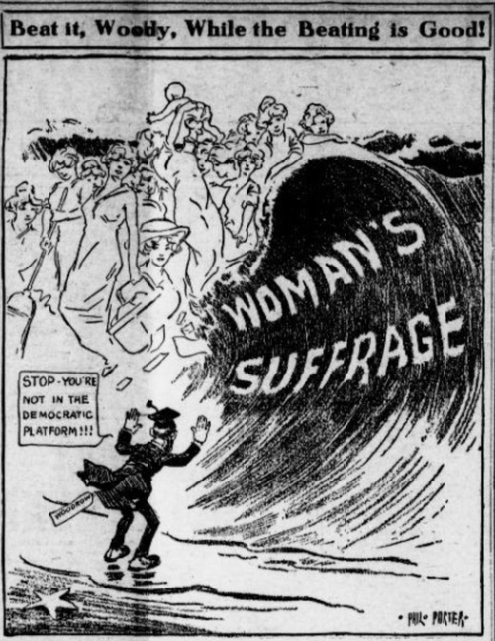

Slide 18
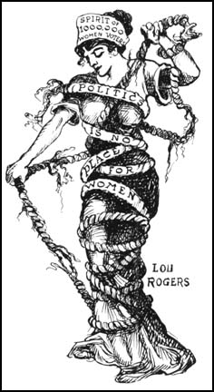
Message, Purpose, Value, limitations

Slide 19
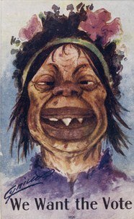
Message, Purpose, Value, limitations

Slide 20
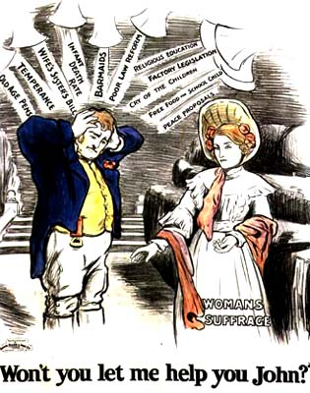
Message, Purpose, Value, limitations

